Slide 1
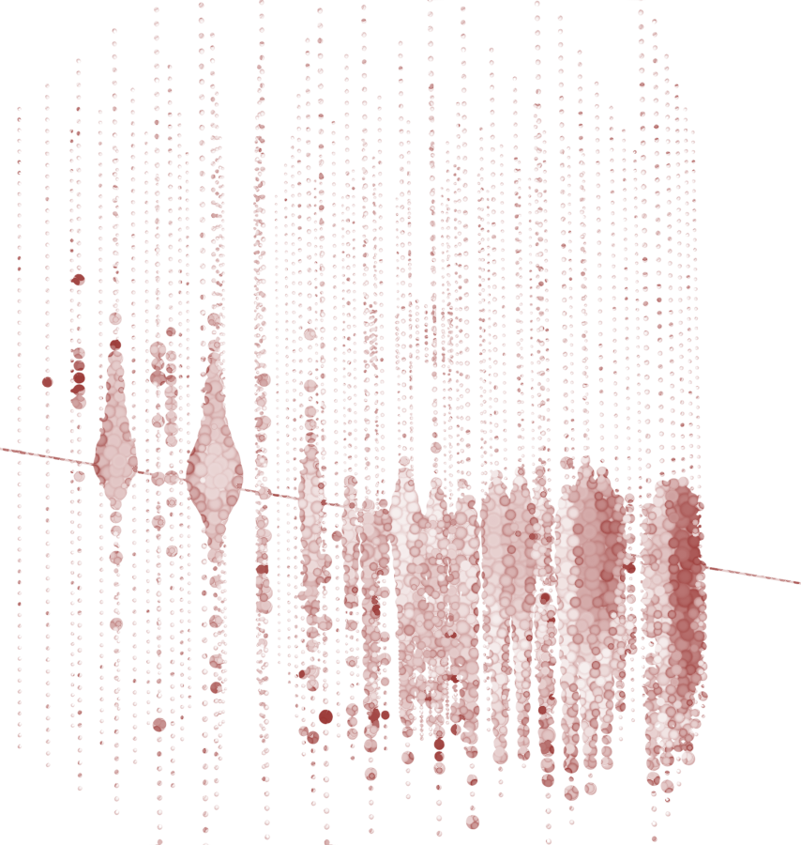



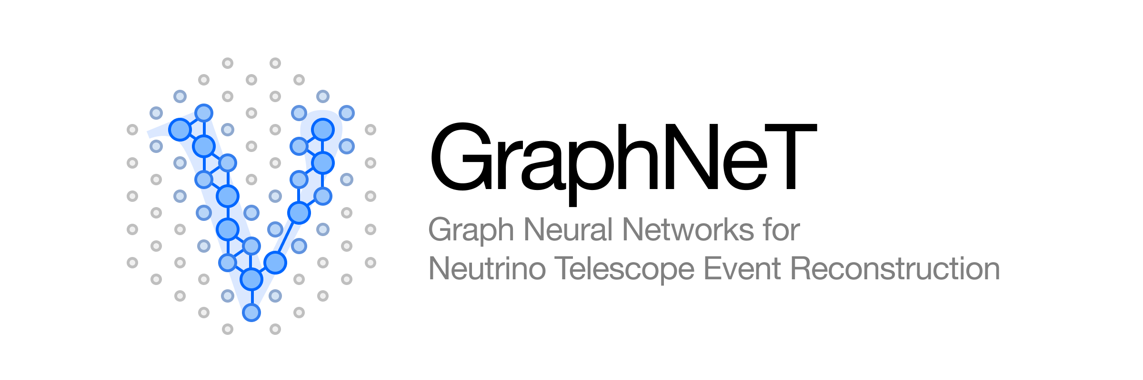
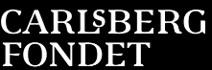

Stopped Muon Reconstruction In IceCube DeepCore
Leon Bozianu

Slide 2

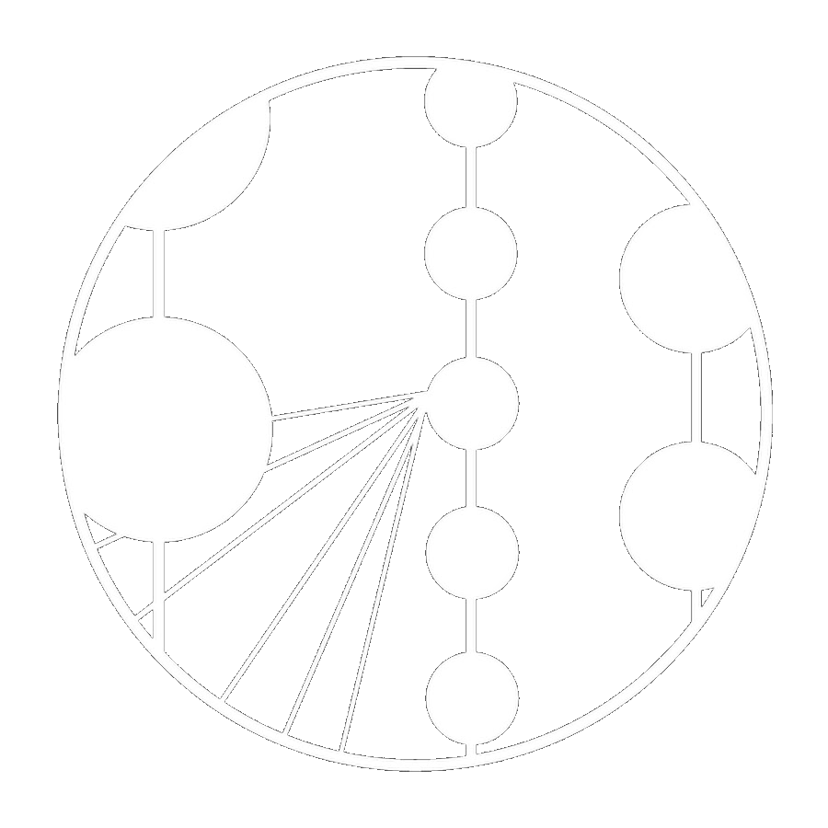
Presentation Outline
Introduction and Concepts
Results and Conclusions
Particle Physics Introduction
The IceCube Detector
Machine Learning & Graph Basics
The DynEdge Model
Classification Results
Stopped Muon Regression Results
Investigation into Systematic Sets
Conclusions & Outlook
Leon Bozianu - Stopped Muon Reconstruction
08/07/2022
‹#›

Slide 3
Motivation
Use GNN for classification
Compare to Real Data
Reconstruct Stopped Muons
Analyse Different Systematic Sets
Leon Bozianu - Stopped Muon Reconstruction
08/07/2022
‹#›

Slide 4
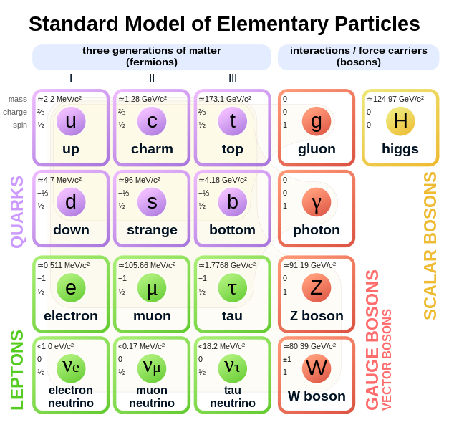
Properties of the Standard Model
Our Focus:
Particle Physics
Twelve fermions - six quarks, six leptons. Make up all matter.
Five gauge bosons - four vector and one scalar boson.
Describes electromagnetic, strong and weak forces via exchange of gauge bosons. Excludes gravity.
Corresponding anti-particles for each fermion with the same mass, opposite charge.
Cannot explain neutrino masses.
Three neutrinos - 𝞶_{e} 𝞶_{𝞵} 𝞶_{𝞽}
(Atmospheric) muons - 𝞵
Figure from https://en.wikipedia.org/wiki/Standard_Model
Leon Bozianu - Stopped Muon Reconstruction
08/07/2022
‹#›

Slide 5
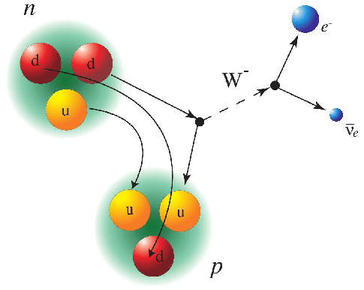
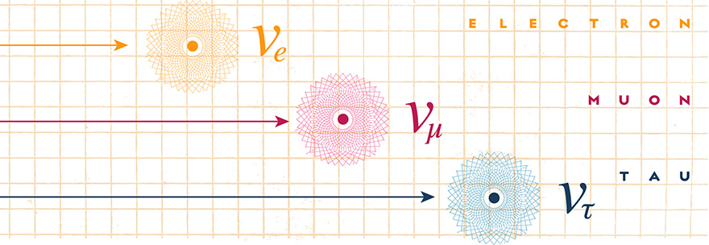
The SM Neutrinos
Particle Physics
The electrically neutral leptons are called neutrinos.
In the SM they are the lightest massive particles.
Each neutrino is the partner of a charged lepton (e.g 𝞶_{e} and e).
Corresponding “anti-neutrino” for each.
Only interact via the weak interaction.
Helaine, Victor. (2014). Neutron Electric Dipole Moment measurement: simultaneous spin analysis and preliminary data analysis.
Leon Bozianu - Stopped Muon Reconstruction
08/07/2022
‹#›

Slide 6
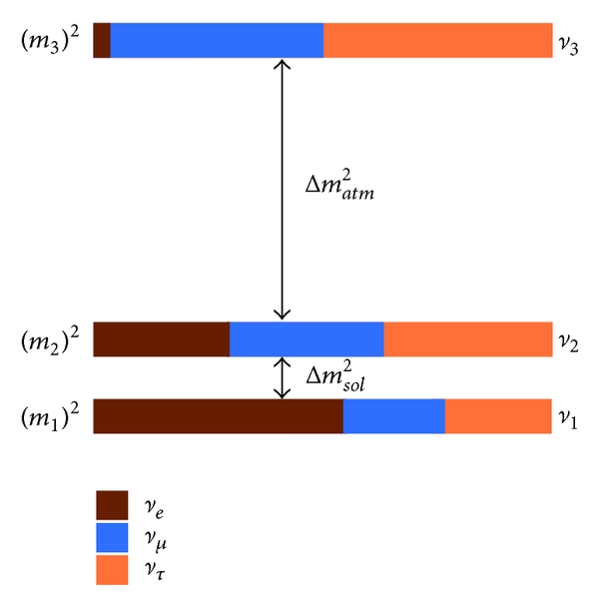
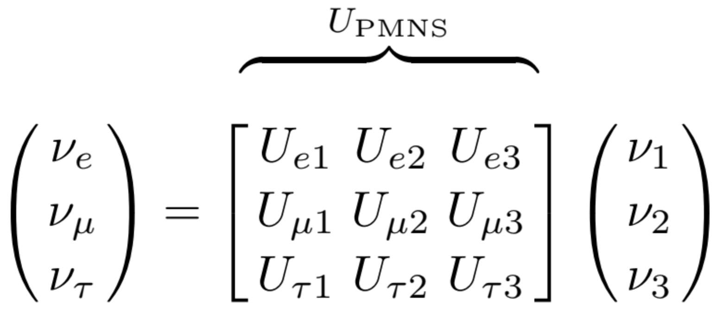
Particle Physics
Neutrino Oscillations
Deficit of solar electron neutrinos ⇒ oscillation!
Produced in flavour states, then propagate in hidden mass states. Flavour states are a superposition of the mass states, related by the PMNS matrix elements.
𝞶₁
[ arXiv:1307.6465 ]
𝞶_{𝞵}
𝞶₂
𝞶_{𝞽}
𝞶₃
Leon Bozianu - Stopped Muon Reconstruction
08/07/2022
‹#›
Notes:
Neutrino oscillations arise from a quantum mechanical phenomenon associated with the fact that the neutrinos have mass. For the three neutrinos species that we know to exist, the principle of superposition allows "flavor" states, namely neutrinos that interact to produce electrons, muons, or taus, to be (orthogonal) combinations of three neutrino states with definite mass. In other words, when a weak interaction produces a flavor state, such as a muon neutrino, that state is a mixture of states with different mass. These states evolve at different rates so that a later time, the state may acquire some component of a new flavor state, such that if it interacts, it may do so as a flavor state different from its original flavor. This possibility of flavor change, namely that a neutrino is created in one flavor and interacts some time later as another, is the primary manifestation of neutrino oscillations

Slide 7
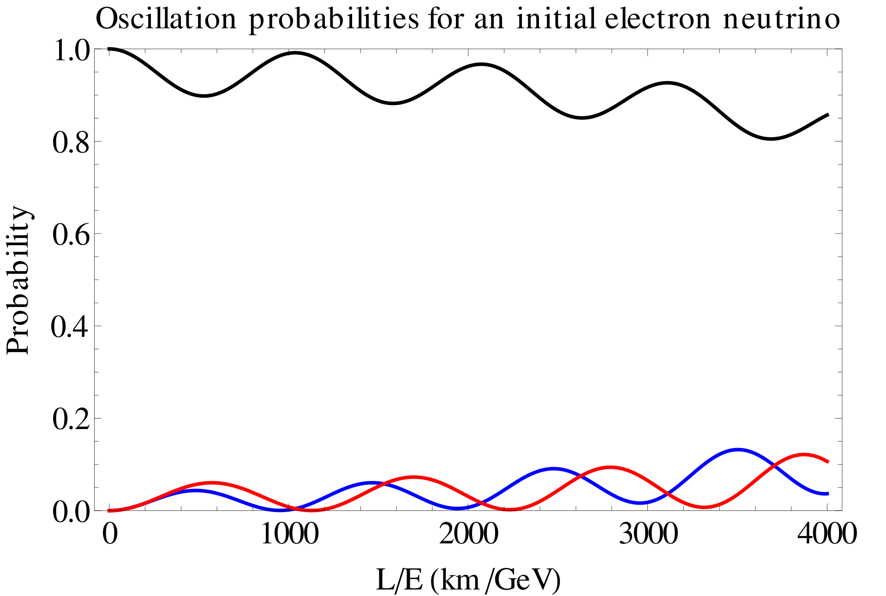
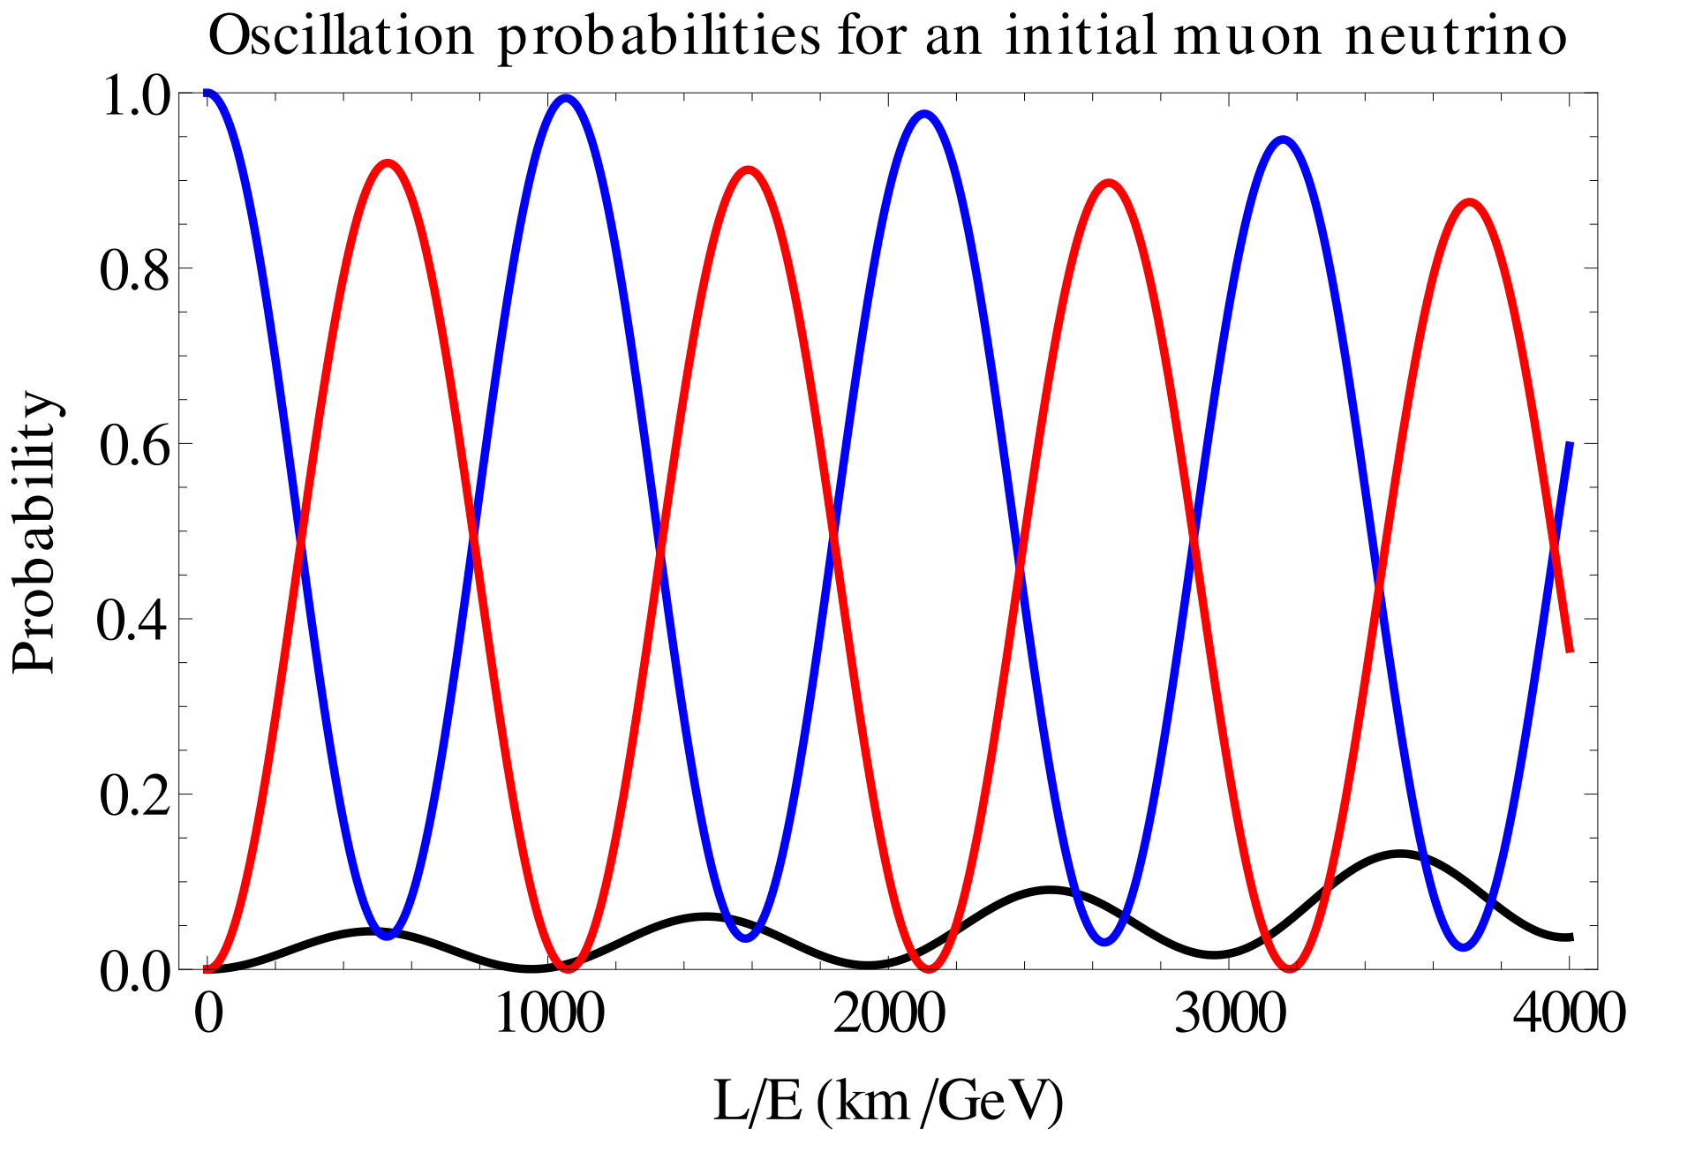

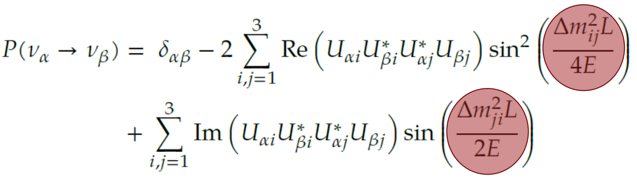
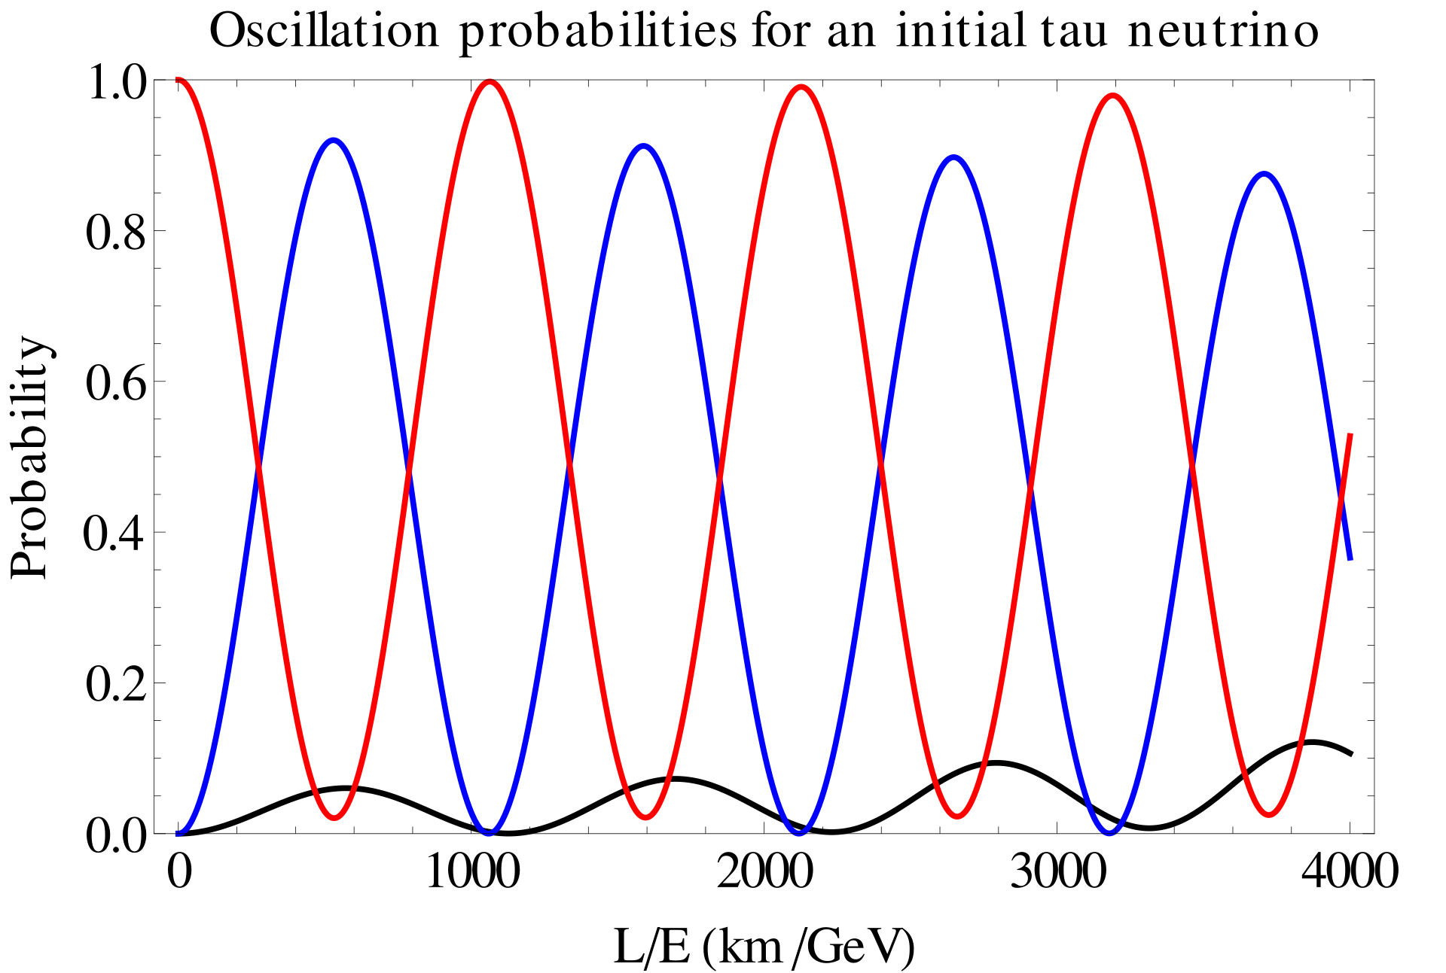

Particle Physics
Evolving the flavour state expansion in time, taking the inner product of this propagating state with a pure flavour state gives the oscillation amplitude.
Leon Bozianu - Stopped Muon Reconstruction
08/07/2022
‹#›

Slide 8
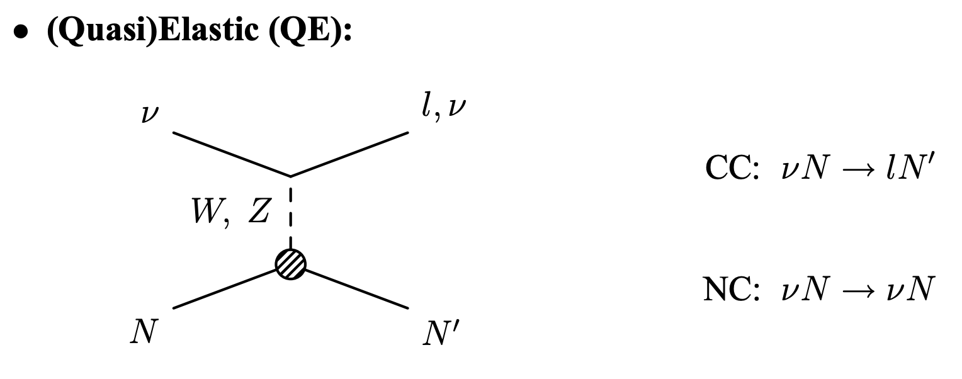
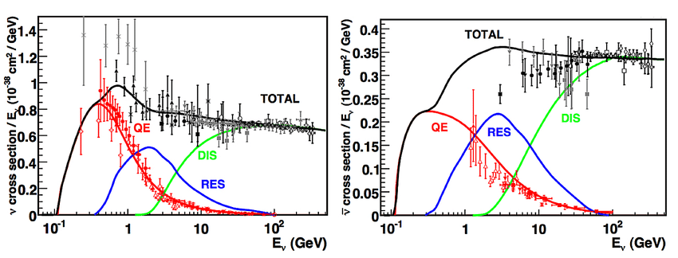
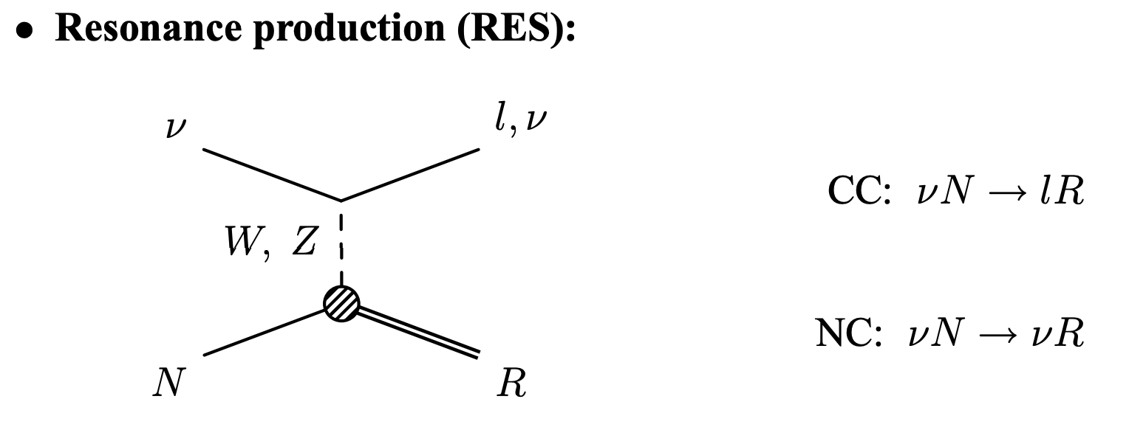
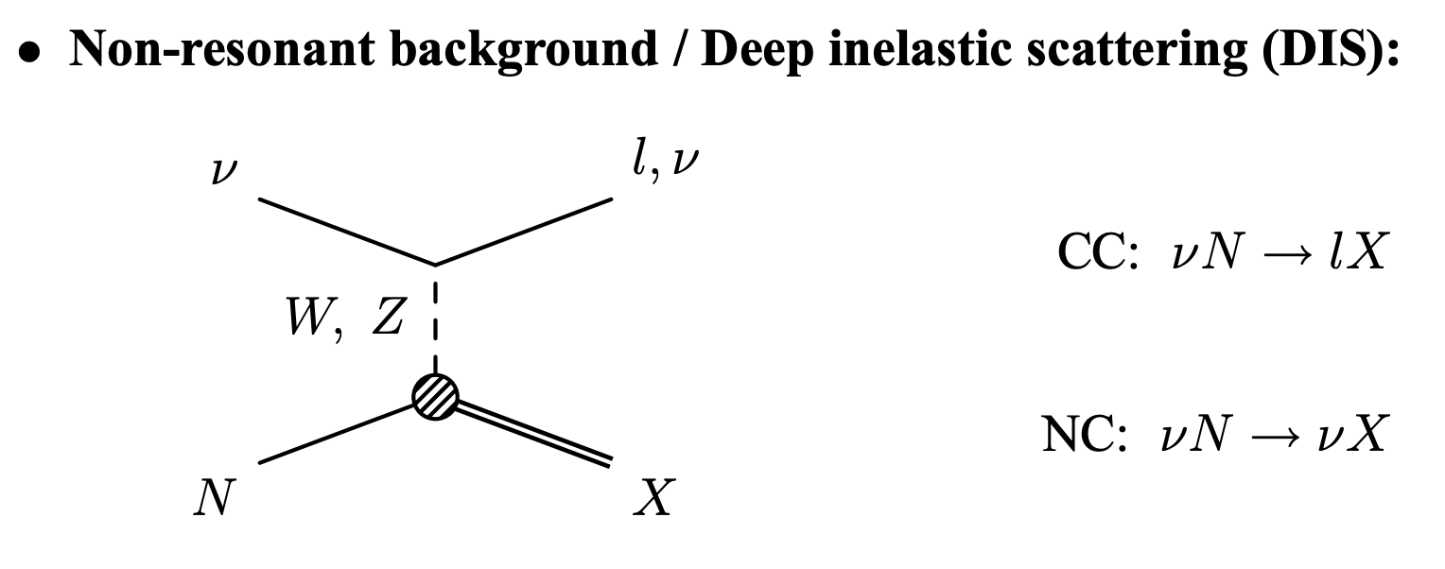
Particle Physics
Neutrino Interactions
[ arXiv:1507.08836]
[ arXiv: Nuclear Theory 842 (2006): 877-879 ]
Leon Bozianu - Stopped Muon Reconstruction
08/07/2022
‹#›

Slide 9
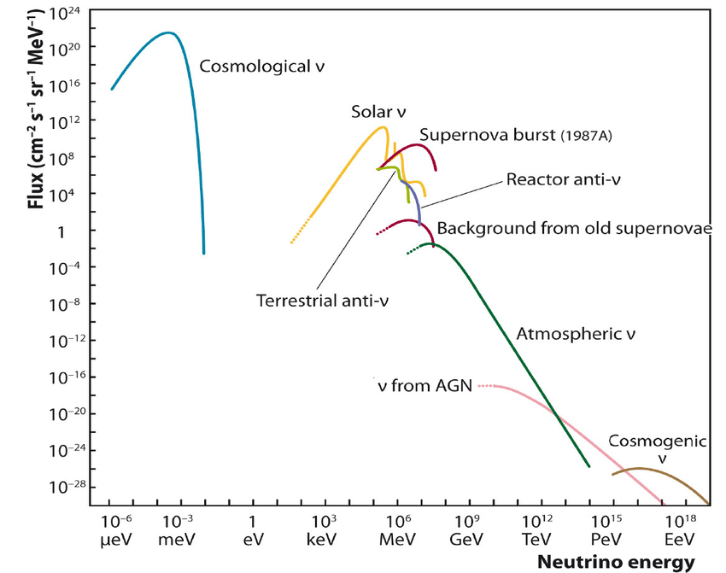
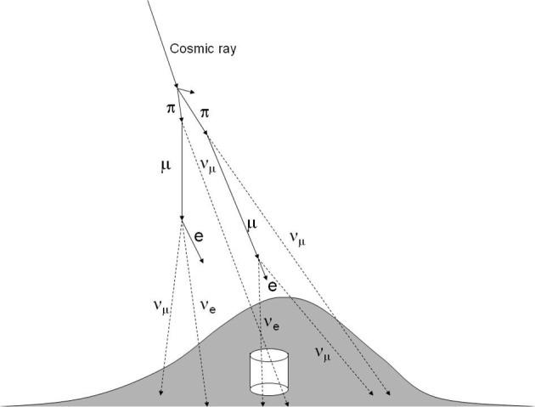
Particle Physics
Where do the neutrinos come from?
Jash, Abhik. (2018). Studies on the Physics of Resistive Plate Chambers in Relation to the INO Experiment.
Figure from Kajita, T. “Atmospheric neutrinos and discovery of neutrino oscillations.”
Leon Bozianu - Stopped Muon Reconstruction
08/07/2022
‹#›

Slide 10
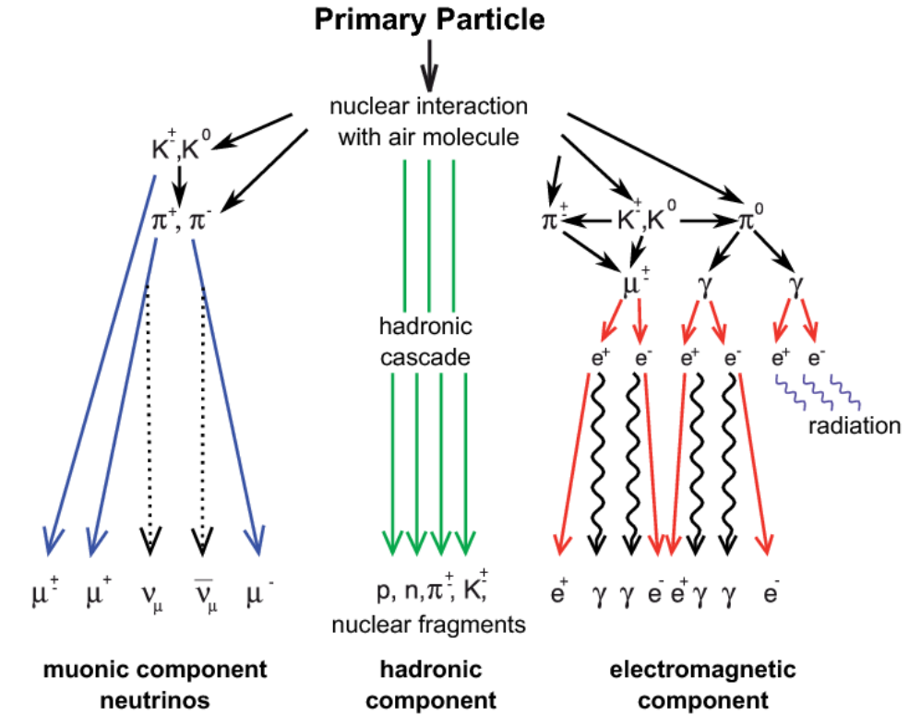
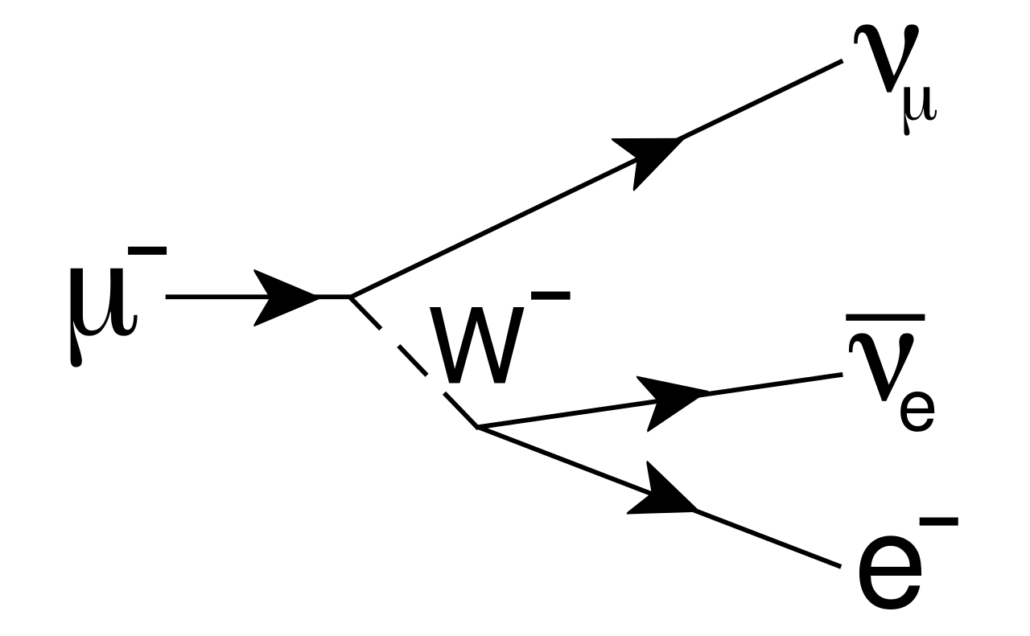
Particle Physics
What about muons?
Second generation charged lepton, identical to the electron, but 200 times more massive.
Unstable, and decays to an electron and neutrinos via weak interaction with lifetime of 2.2 𝞵s.
Decays of pions in the atmosphere produce muons. Despite the short lifetime muons can reach (and penetrate) the Earth’s surface at sufficiently high energy.
https://cupdf.com/document/cosmic-rays-5685c81ce4481.html?page=6
Leon Bozianu - Stopped Muon Reconstruction
08/07/2022
‹#›

Slide 11
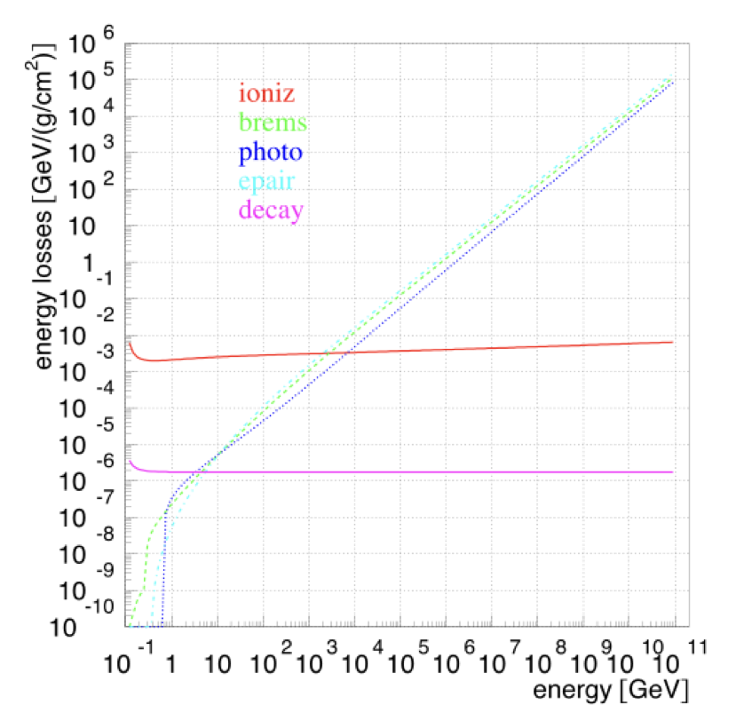
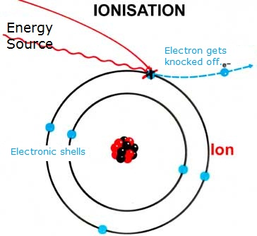
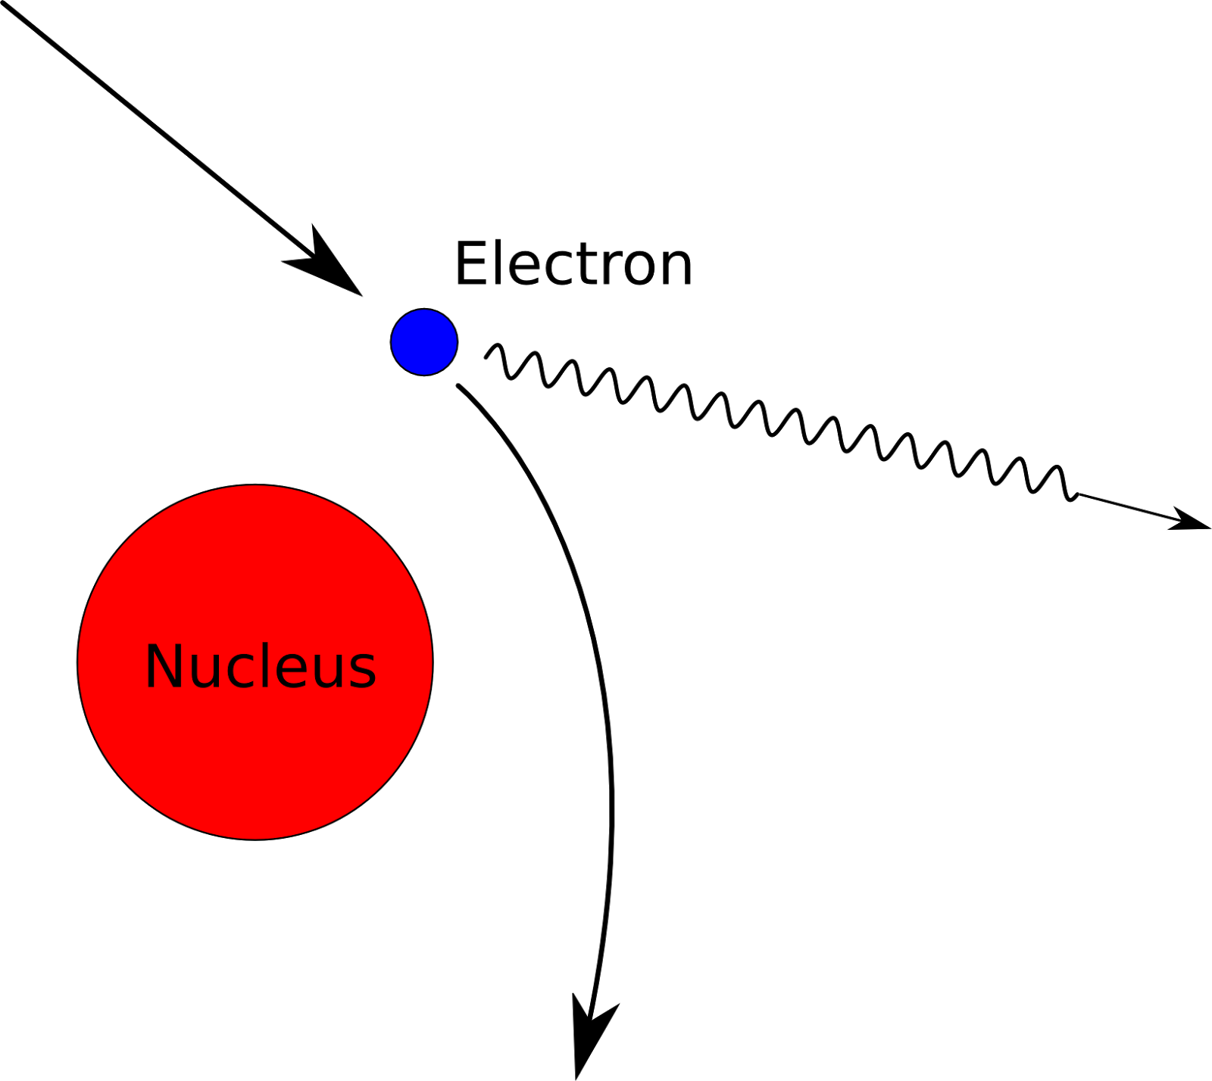
Particle Physics
Muon Energy Losses
During propagation through matter muons lose energy both continuously and stochastically:
Ionization
Radiative losses
Pair production
Photonuclear interaction
Leon Bozianu - Stopped Muon Reconstruction
08/07/2022
‹#›
(Cherenkov only a tiny contribution)
Notes:
Ionization - continuous. High energy particles, energetic enough to ionize atoms in matter. Also includes excitations of electrons in matter. Ionization loss dependent on density of medium, charge of incident particle, speed of particle Occurs continuously along the muon trajectory, nearly energy independent. Dominant until 500GeV.
Radiative (bremsstrahlung) losses - discrete. At high energies, this dominates. Emission probability is proportional to the inverse square of the particle mass, so energy loss for muons is 40,000 times smaller for muons than electrons. Energy dependent. In the discrete processes energy is lost in bursts along the path.
Pair production - discrete. Energetic charged particles can also produce electron-positron pairs Energy dependent
Photonuclear interactions of muons (or electrons or taus) - discrete. energy transfer to nucleus via photon, producing energetic hadrons (like a hadronic interaction of a proton). Energy dependent

Slide 12
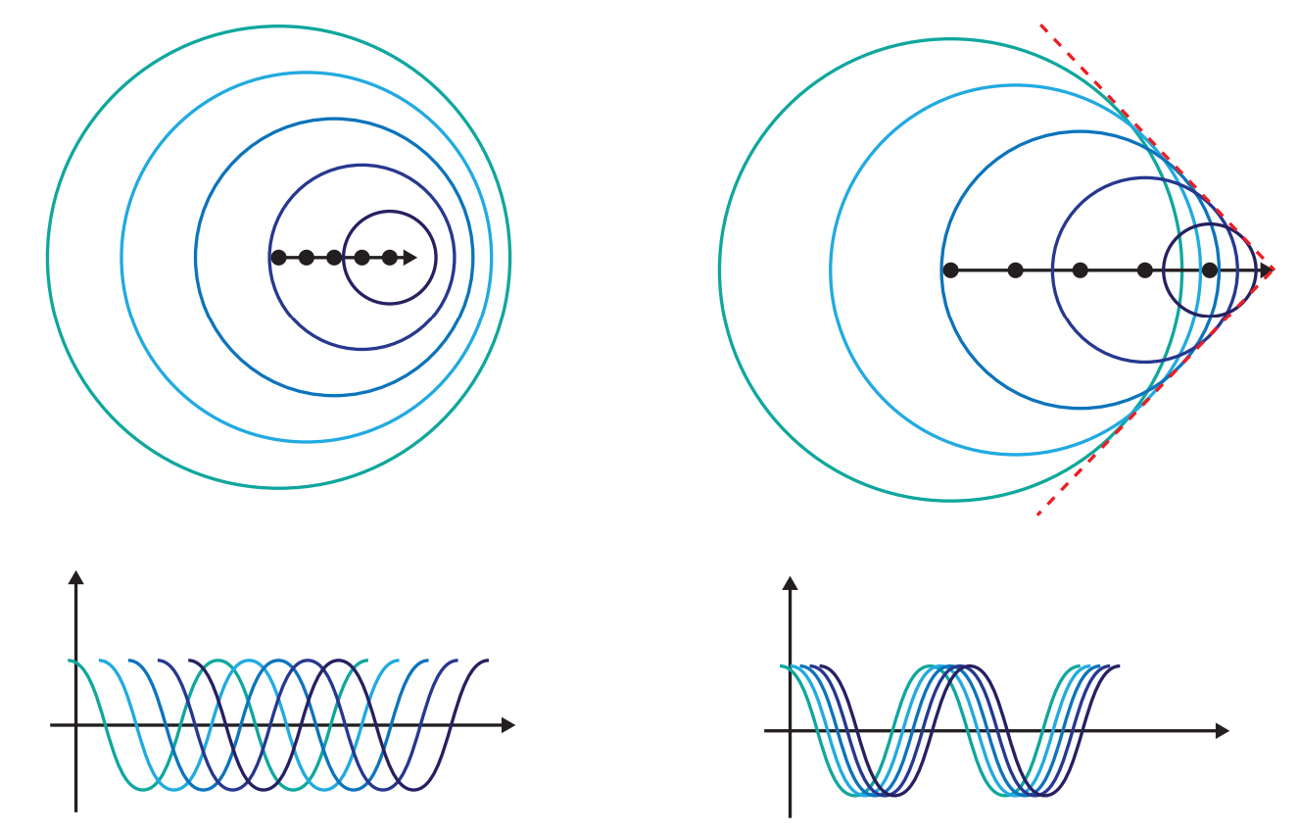
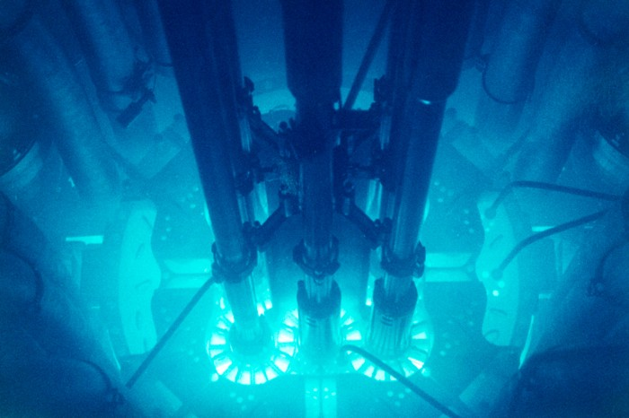
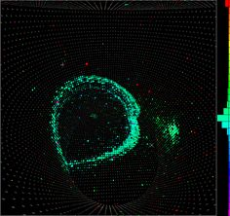
Particle Physics
Cherenkov Radiation
A charged particle travelling through a medium faster than light (in the medium) emits radiation.
The charged particle momentarily polarizes atoms in the medium, when returning to their ground state these electrons emit Cherenkov.
Radiation emanating spherically outwards constructively interferes ⇒ coherent emission.
Leon Bozianu - Stopped Muon Reconstruction
08/07/2022
‹#›
Notes:
Suppose a particle emits a wave pulse every time t, and also that these pulses move out spherically at speed c'. Now allow the particle to move with speed v. If v <c', then the wavecrests merely bunch up in the direction of motion, but do not cross. When v > c' , however, the wavecrests do cross, adding up constructively at some angle &theta
Consider that a charged particle, in passing by the atoms in the dielectric, momentarily polarizes them (pushing like charges in the atom away, and inducing a dipole state). Once the particle has passed, this polarized state collapses, causing each atom to emit Cerenkov radiation For slow moving particles, the polarization is perfectly symmetrical, resulting in no electric field at long distances (and thus no radiation). When the particle is moving very quickly however, the polarization is no longer perfectly symmetrical.
The emission is due to an asymmetric polarization of the medium in front and at the rear of the particle, giving rise to a varying electric dipole momentum.

Slide 13
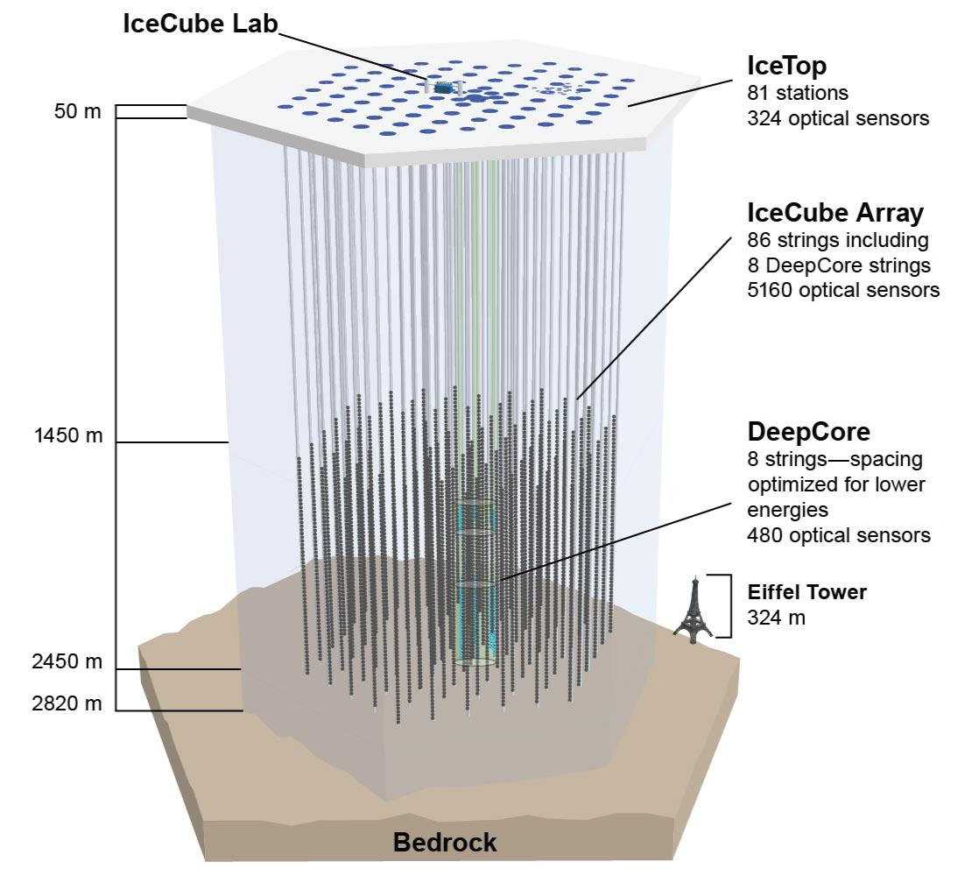
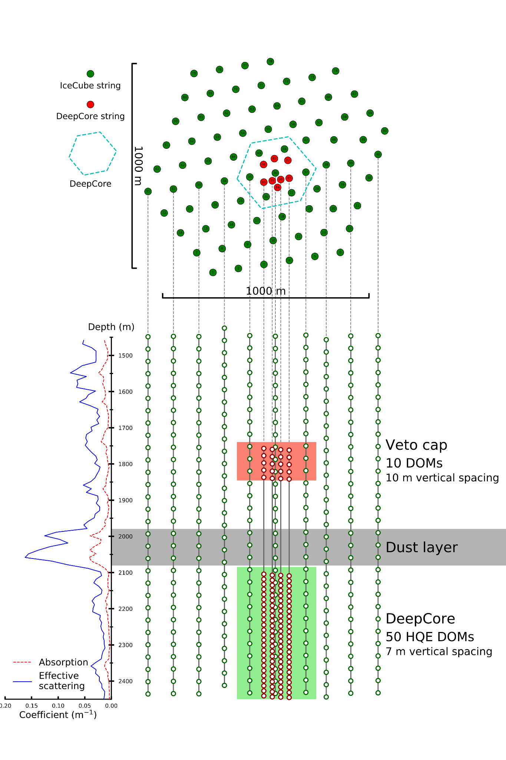
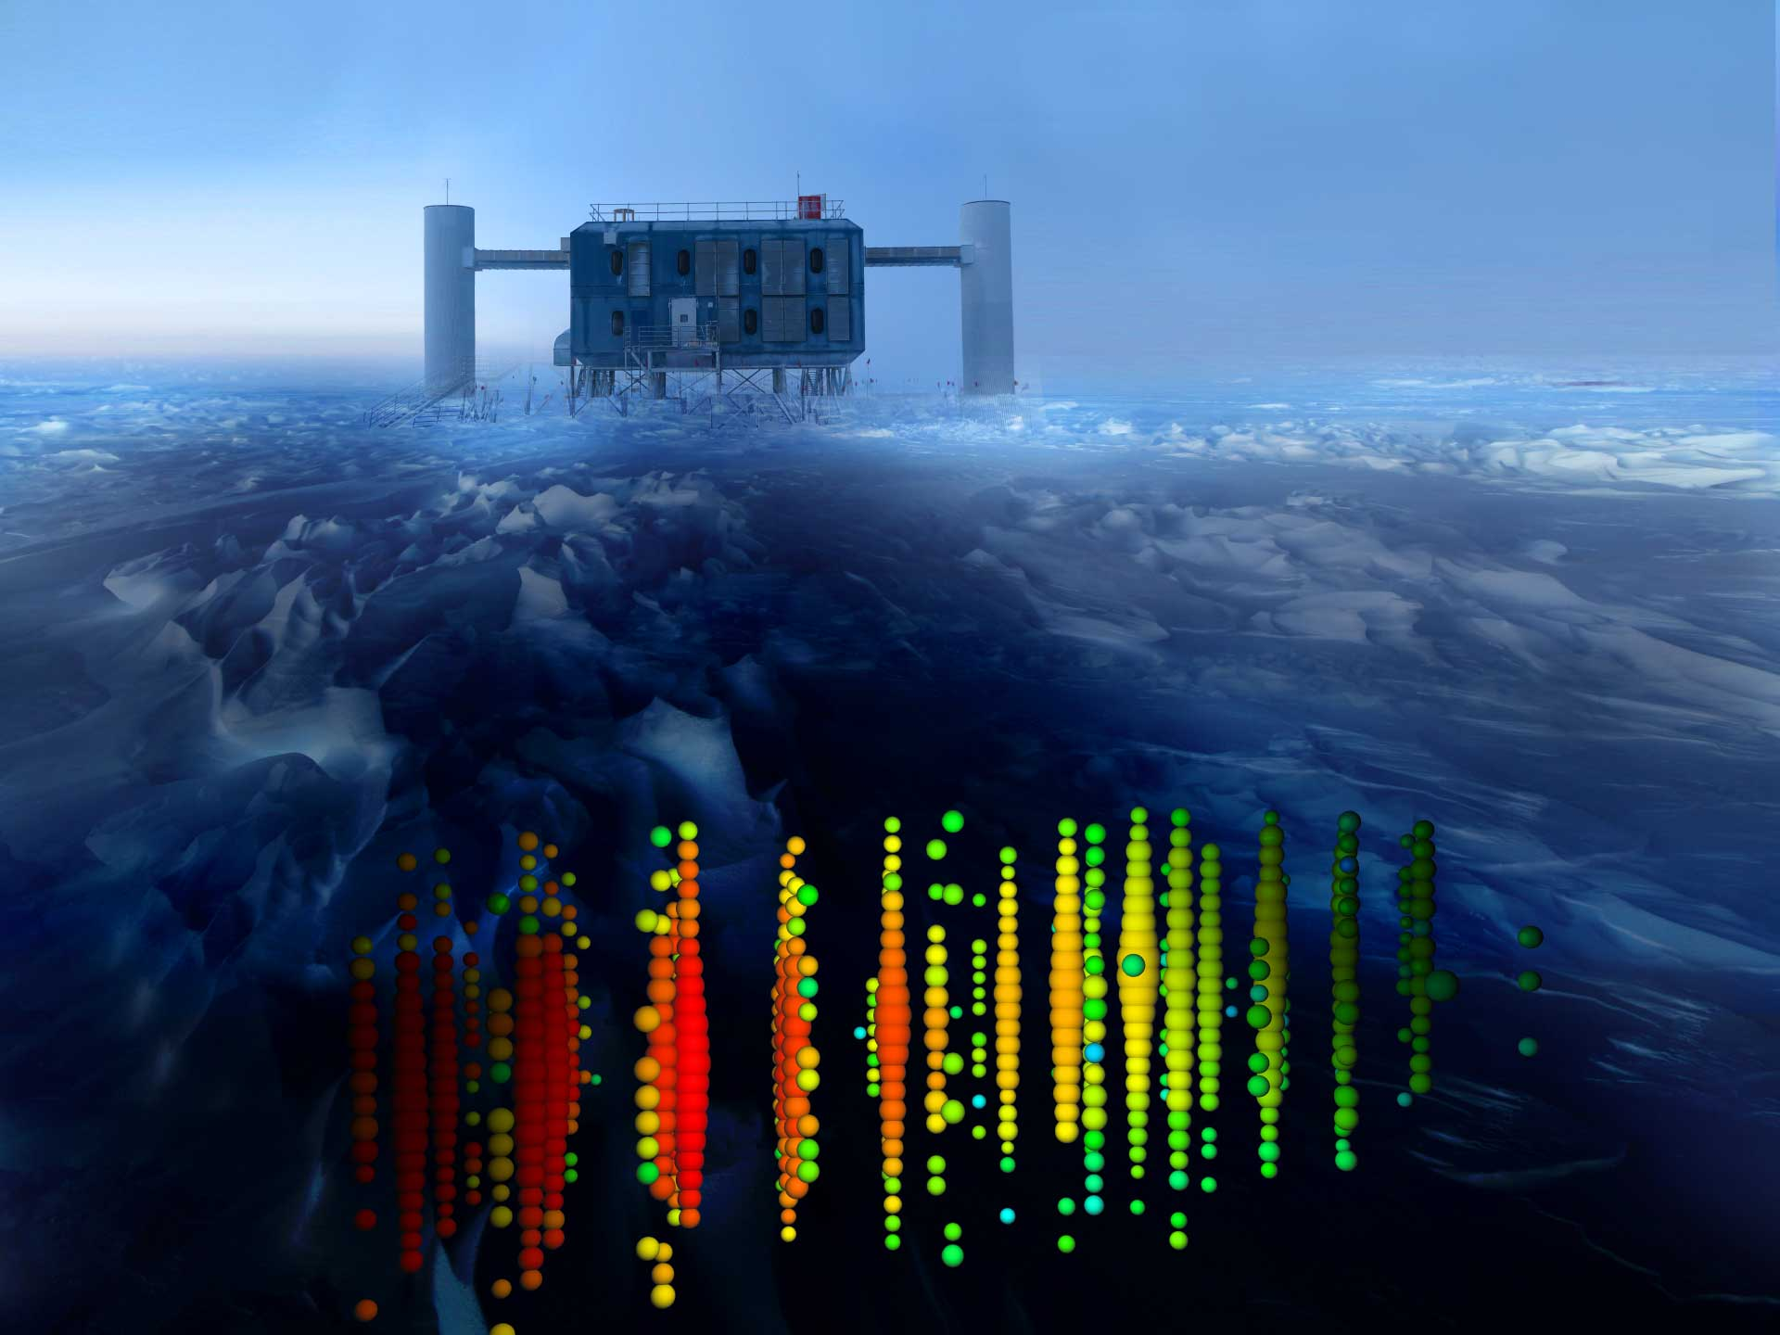
The IceCube Detector
arXiv:2203.02303 [hep-ex]
Leon Bozianu - Stopped Muon Reconstruction
08/07/2022
‹#›

Slide 14
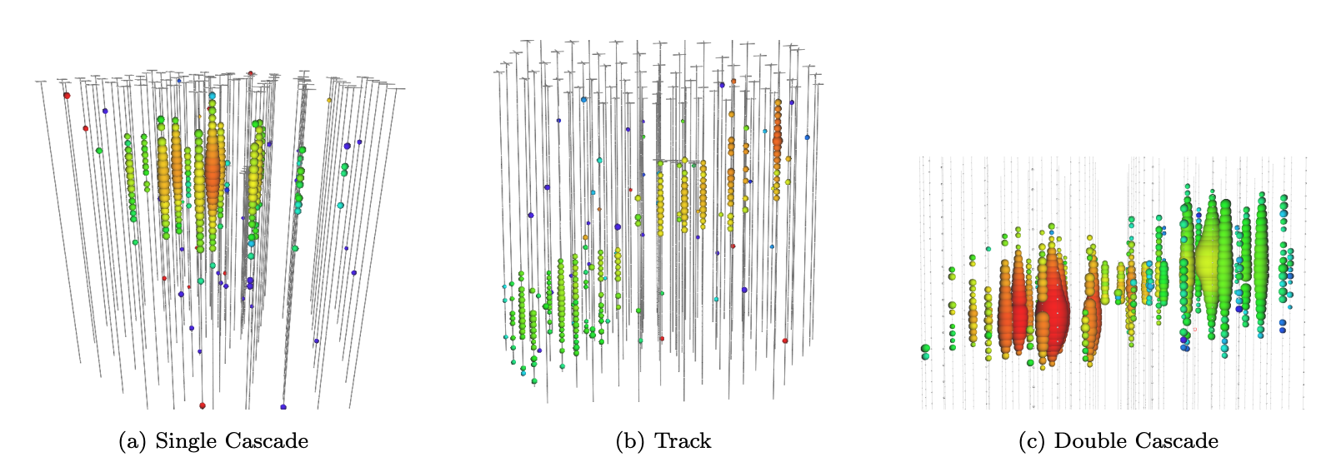
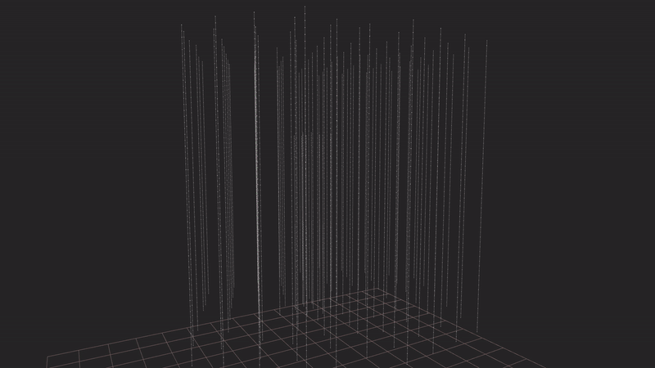
The IceCube Detector
Events In The Ice
100 TeV muon neutrino photon propagation simulation.
Leon Bozianu - Stopped Muon Reconstruction
08/07/2022
‹#›

Slide 15
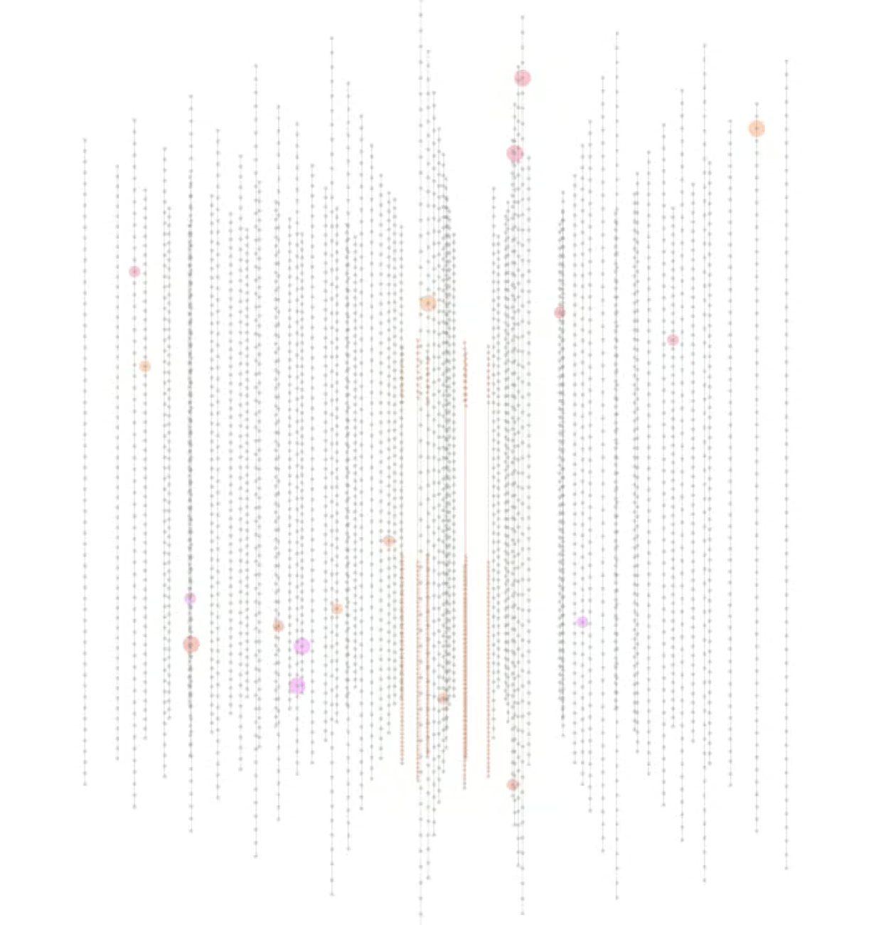
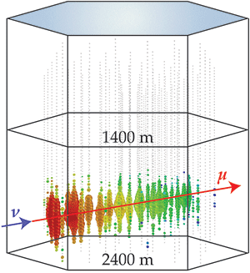
The IceCube Detector
High Energy
Low Energy
Figure from https://physics.aps.org/articles/v7/88
Low energy neutrino candidate in DeepCore figure courtesy of Jason Koskinen
Leon Bozianu - Stopped Muon Reconstruction
08/07/2022
‹#›

Slide 16
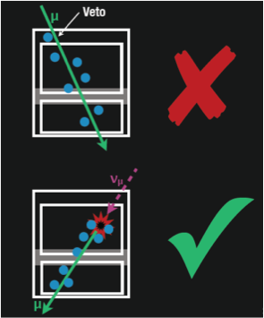
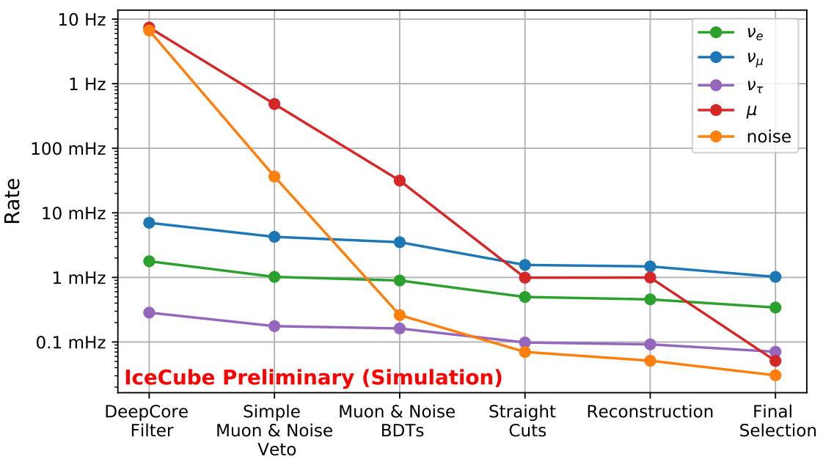
The IceCube Detector
Event Selection in IceCube
DeepCore filter is first check events must pass. Compares the pulses outside DeepCore with a calculated CoG in the fiducial volume. If the time/position difference supports a muon hypothesis, pulse is tagged.
More than 1 tagged pulse ⇒ event removed.
This work
Previous deployment
Leon Bozianu - Stopped Muon Reconstruction
08/07/2022
‹#›
Notes:
The DeepCore filter begins by searching for SMT3 events in the DeepCore fiducial volume. Looking at these events’ pulses a CoG (average x,y,z position) is calculated for the hits in DeepCore fiducial volume.
Compare this to hits outside the DC fiducial volume by calculating apparent velocity if apparent velocity is within a time window of 0.25m/ns to 0.4m/ns, that hit is tagged as a VetoWindowHit. Events with more than one VetoWindowHit are removed.

Slide 17
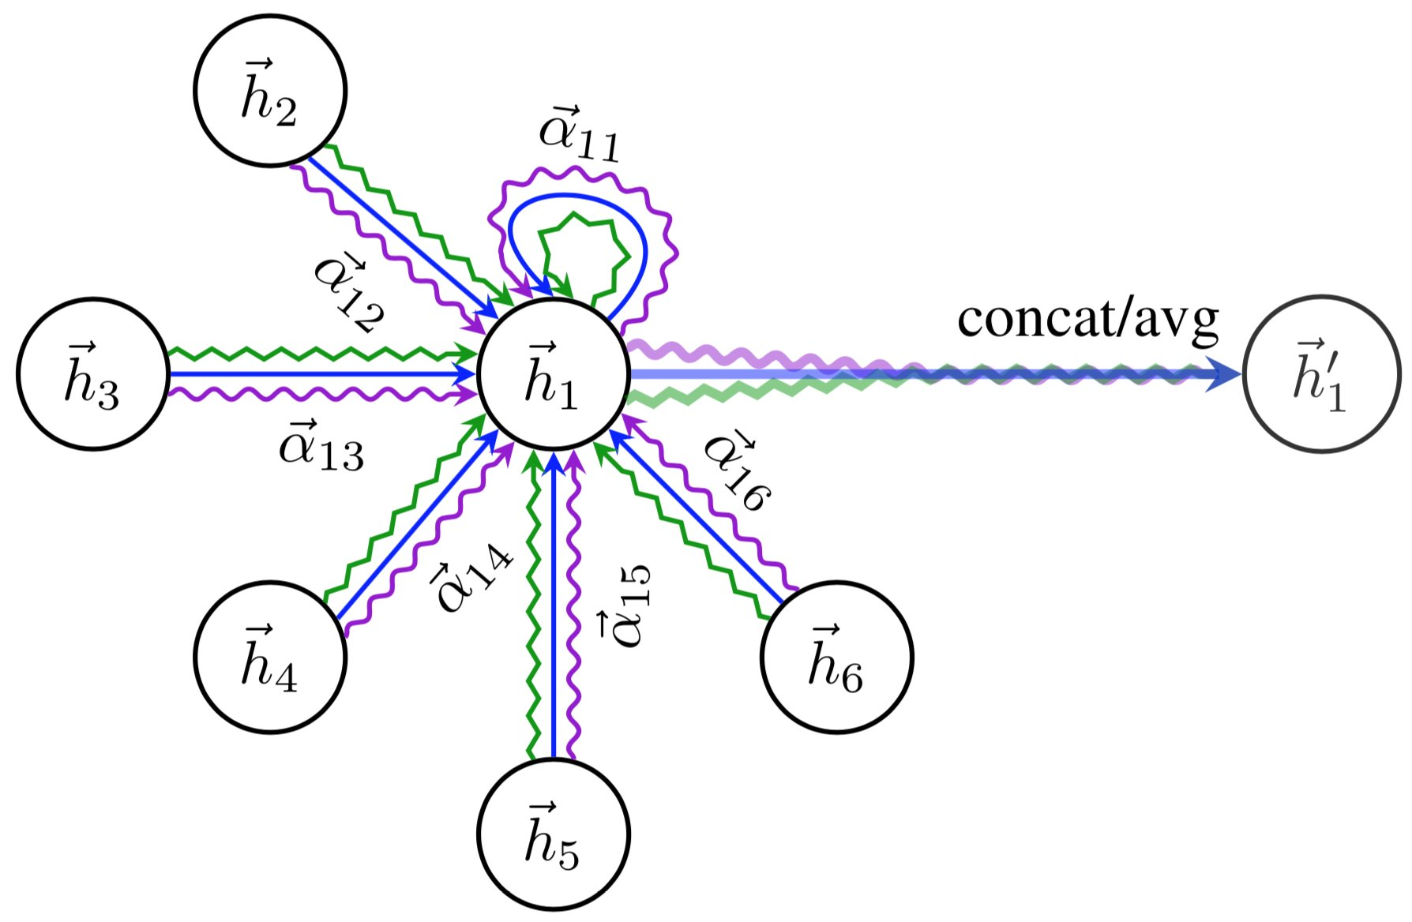
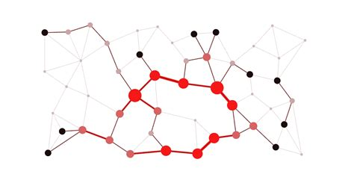
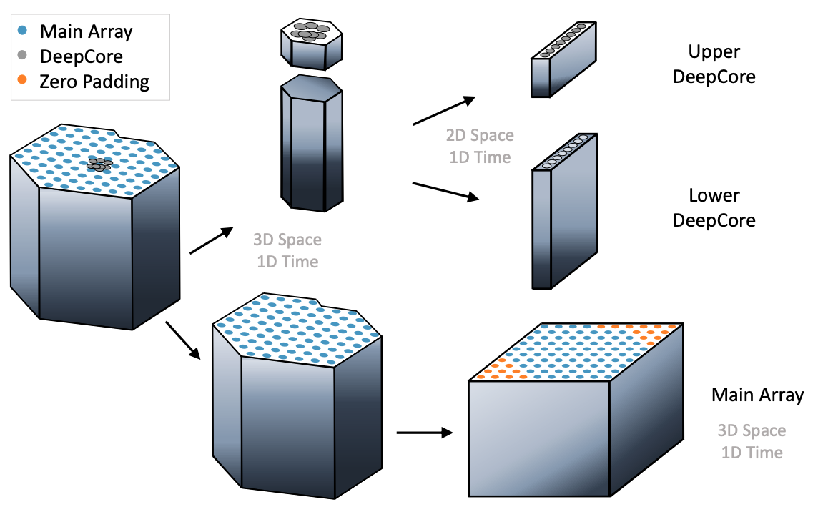
Machine Learning
IceCube Challenges for ML
1. Speed and performance requirements.
2. Geometry of the current detector.
3. Complex, heterogeneous pulsemaps. (Non-fixed size of events).
4. High-dimensionality of input data.
The Good News:
Graph Neural Networks (GNNs) address many of these challenges. They can take as input an arbitrary graph, regardless of geometry/dimension.
Accommodating the spatial relation of input data through adjacency. A natural representation of event topology - importantly permutation invariant.
Lots of available training data.
Data is labelled on an event-level.
Other ML methods as comparison/benchmark.
(Shared) Access to NBI’s GPUs.
[ arXiv:2101.11589]
https://sailab.diism.unisi.it/gnn/
https://mila.quebec/en/publication/graph-attention-networks/
Leon Bozianu - Stopped Muon Reconstruction
08/07/2022
‹#›

Slide 18
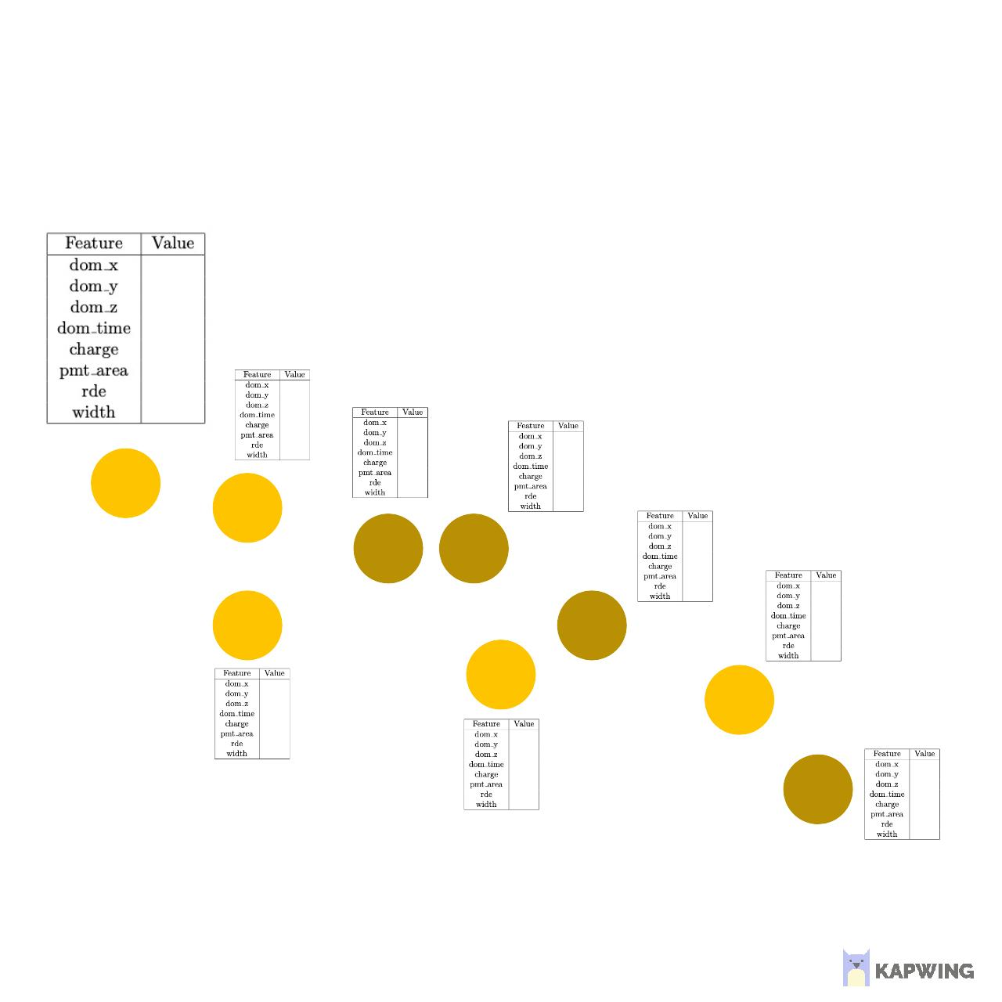
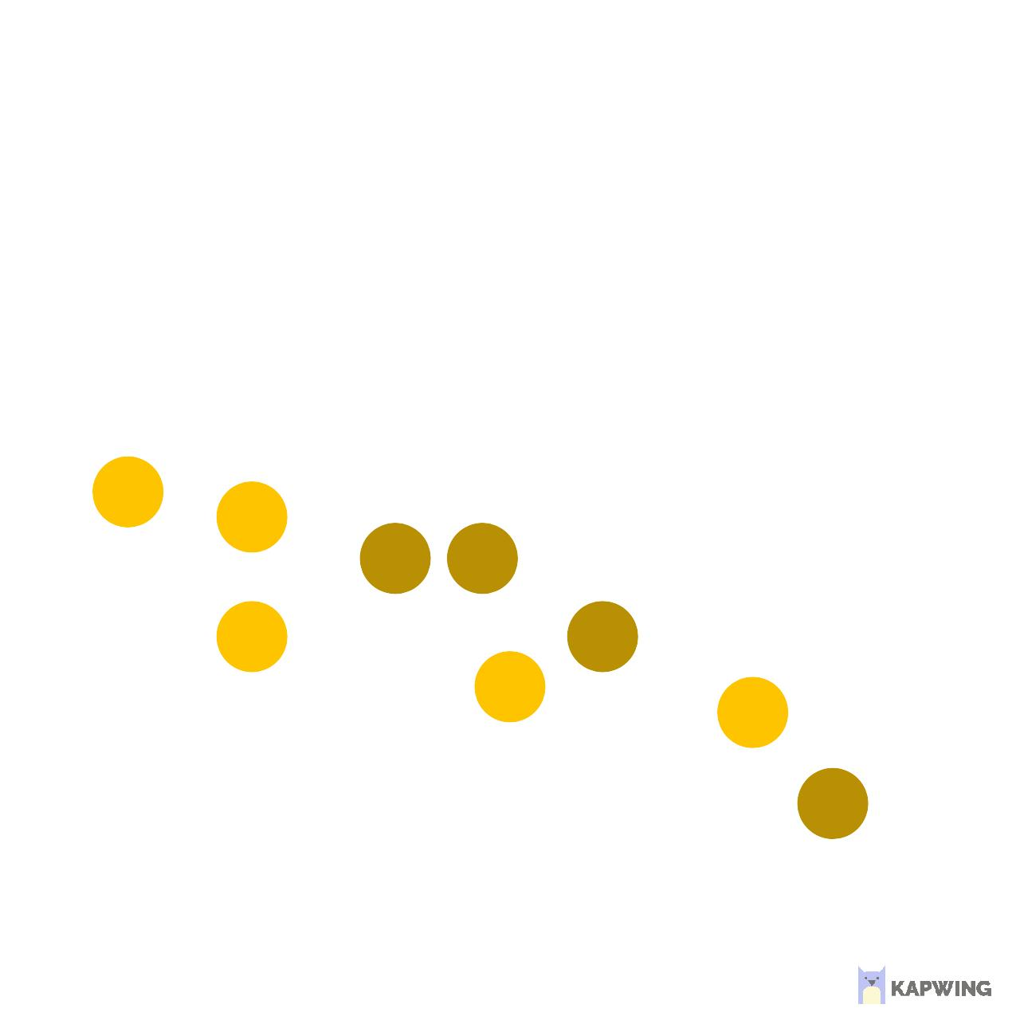
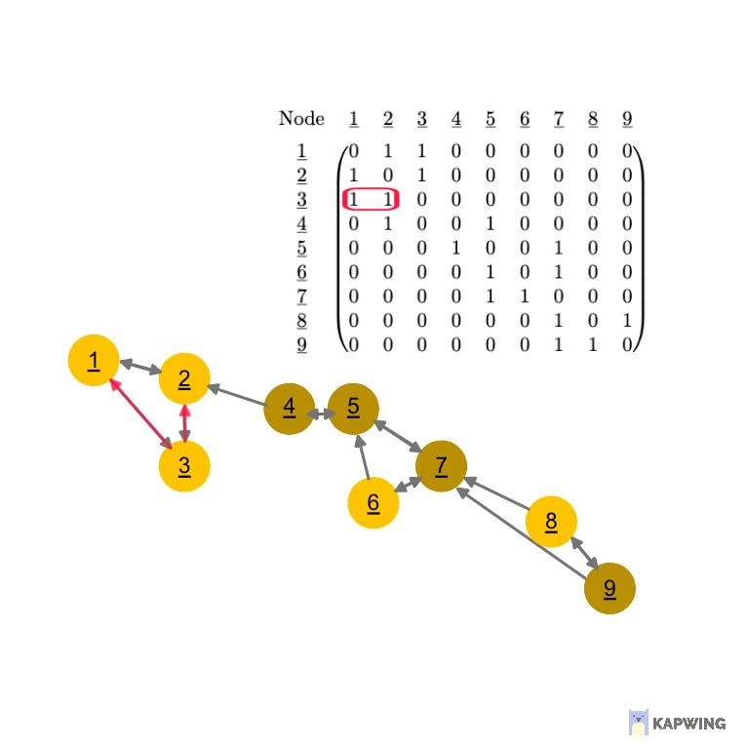
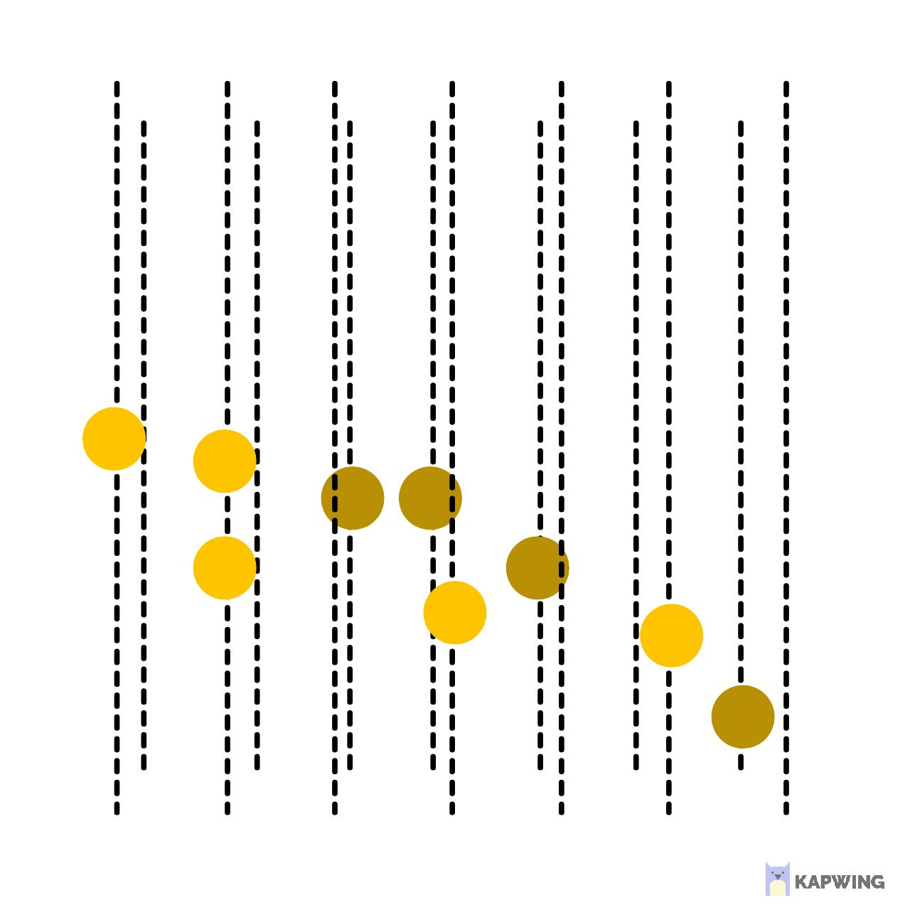
Machine Learning
Representing IceCube events as Graphs
1. Take pulsemap from the relevant i3-file.
2. Disregard DOMs that have not been triggered.
3. Take each triggered DOM as a node in the graph.
4. Associated with each node is a set of node features: position, time, charge, efficiency, etc..
5. Use edges to connect the nodes; here defined by k=2 nearest neighbours.
6. This graph is then the input to the GNN.
Leon Bozianu - Stopped Muon Reconstruction
08/07/2022
‹#›

Slide 19
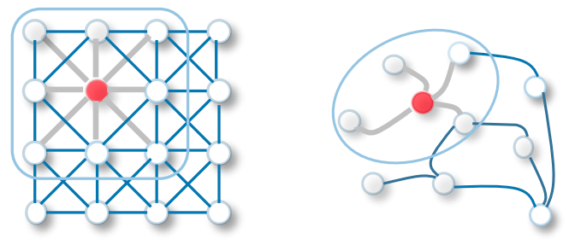
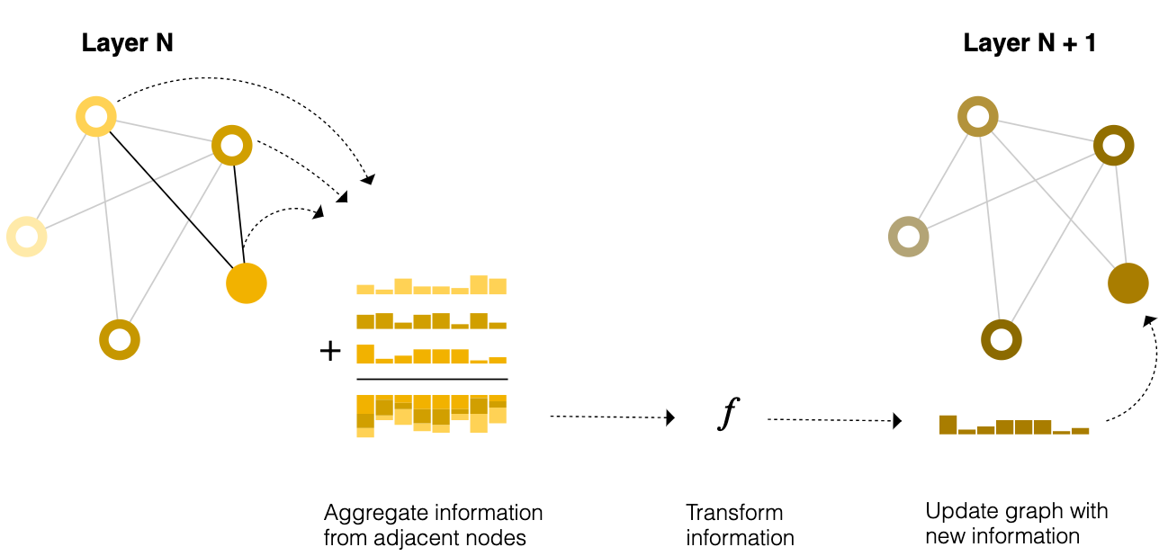
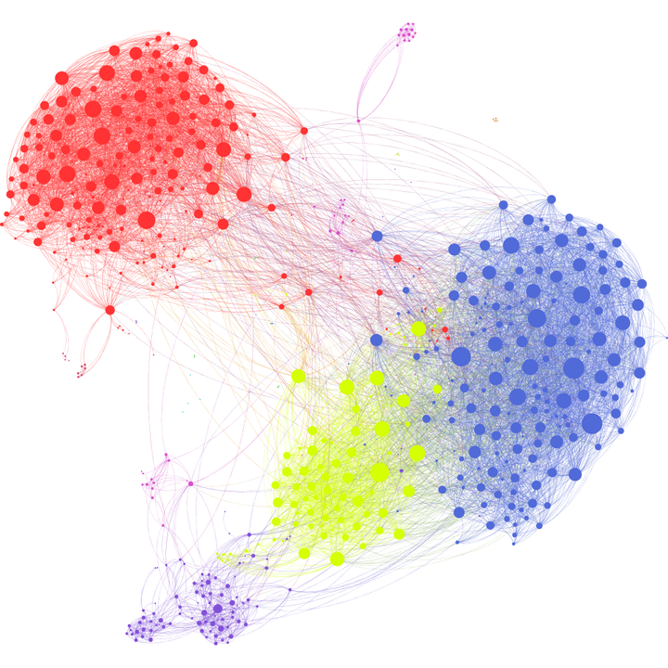
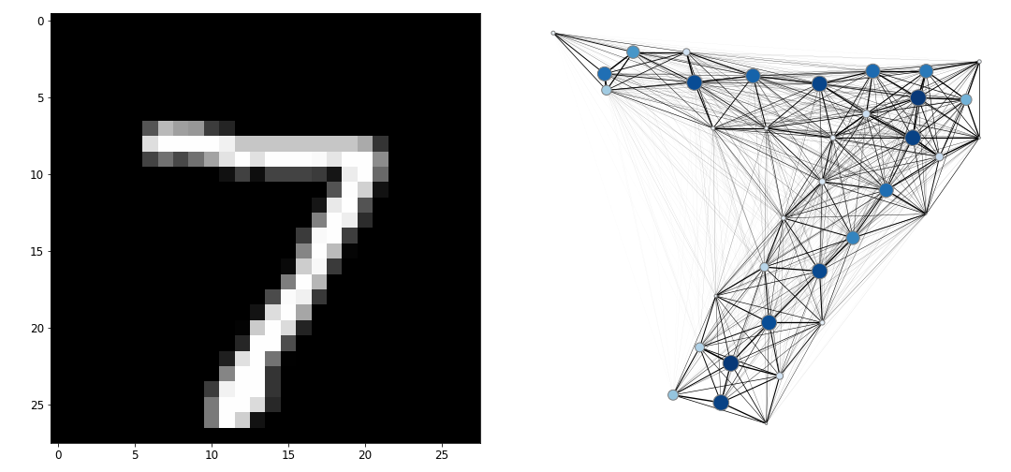
Machine Learning
Introduction to Graph Neural Networks (GNNs)
GNNs act directly on nodes and edges. Message passing schemes exchange information between connected nodes.
Wider neighbourhoods explored by stacking successive layers.
https://github.com/crisostomi/virality-prediction
https://iq.opengenus.org/graph-convolution-network/
https://distill.pub/2021/gnn-intro/
Leon Bozianu - Stopped Muon Reconstruction
08/07/2022
‹#›
Notes:
One way to think about GNNs is as a generalisation of the operation of convolutional neural networks to abstract mathematical objects rather than images. They rely on message passing schemes.
The architecture accepts a graph as input with information loaded into its nodes and edges and progressively transforms these embeddings. Each node gets updated by a simple MLP producing some new node embedding.

Slide 20
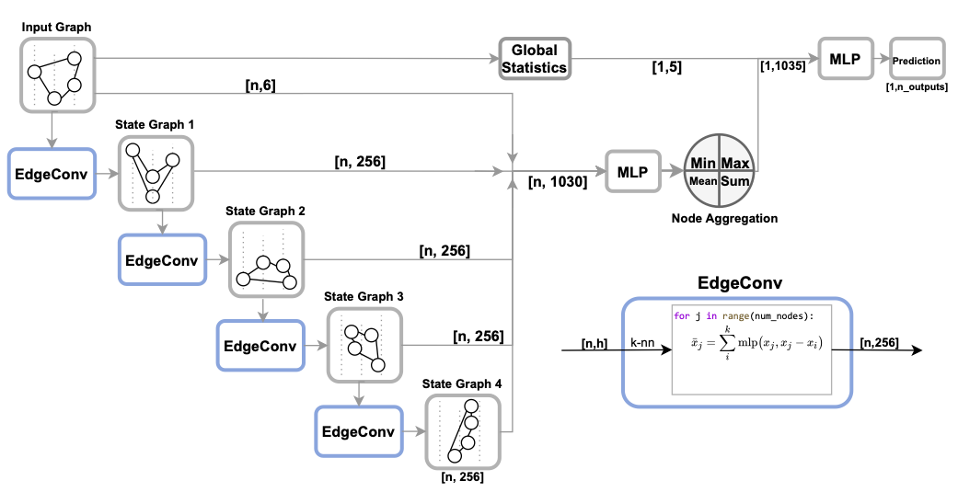
Machine Learning
The DynEdge Model
Global Statistics:
N_pulses
Node homophily ratio x,y,z,t
Leon Bozianu - Stopped Muon Reconstruction
08/07/2022
‹#›
Notes:
Node homophily- the homophily ratio is the ratio of connected node pairs that share the same node feature, and thus a number between 0 and 1. The homophily ratio of xyz indicates what fraction of connected pulses originate from the same PMT. For a graph where all nodes are connected to each other, a value of 0.5 indicates that half the pulses in the event are same-PMT pulses.
As such, the homophily ratio quantifies how many of the pulses originate from the same PMT and how many of the pulses happened at the same time

Slide 21
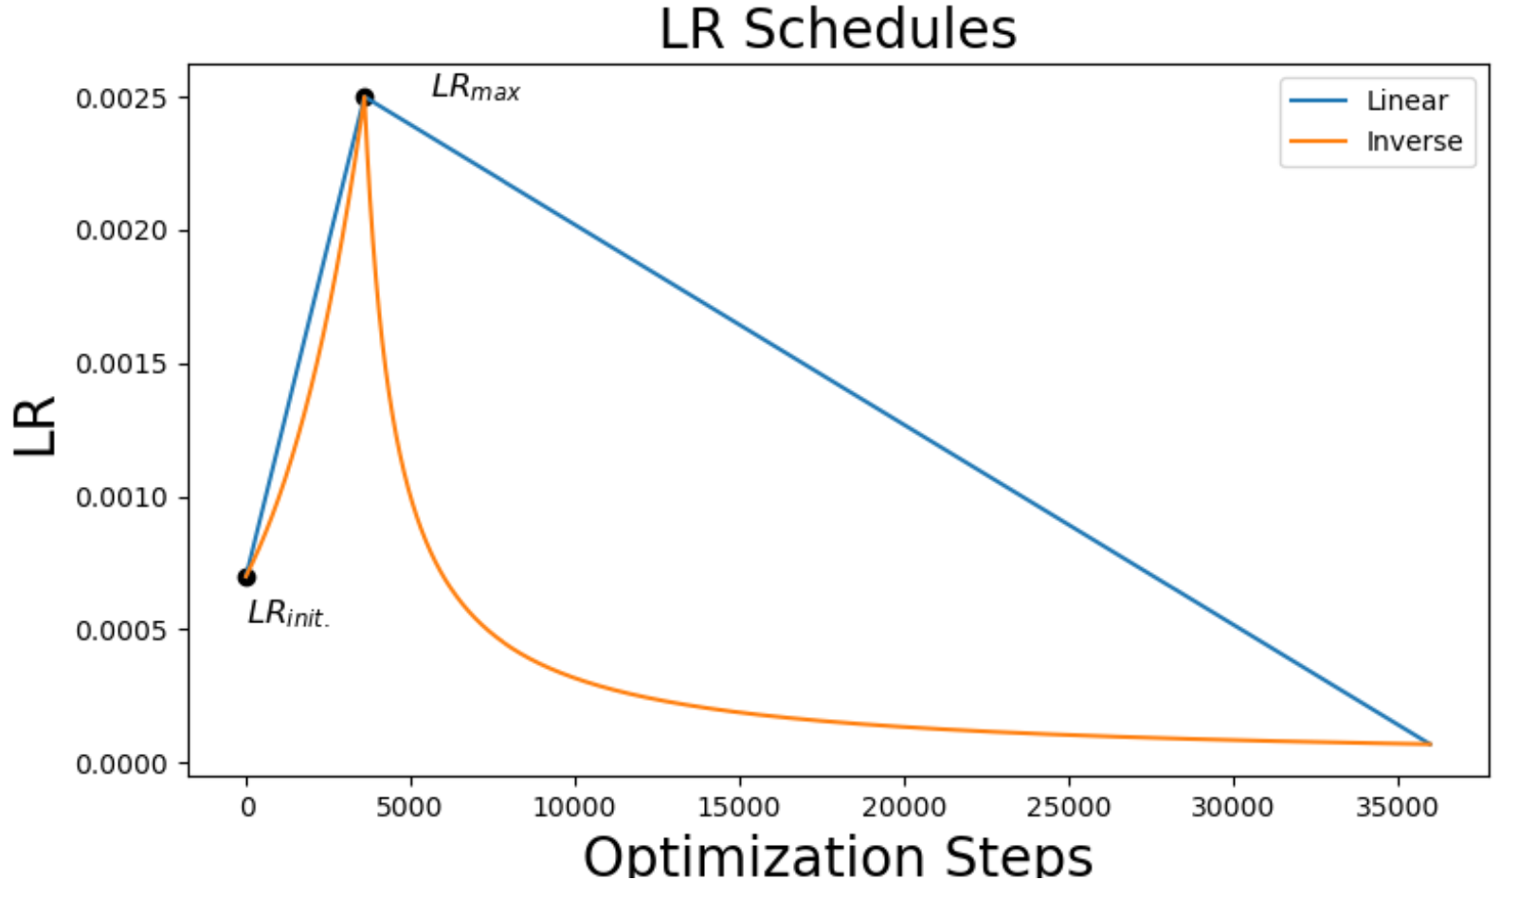
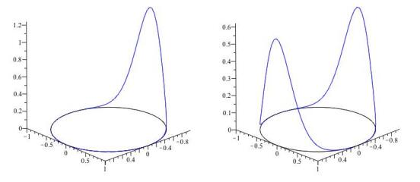
Machine Learning
Important Hyperparameters
Optimizer: ADAM (Adaptive Moment estimation - SGD) .
Early stopping: Validation loss monitoring, patience 5 epochs.
Learning rate scheduler: Linear piecewise scheduler.
Loss functions:
Classification - Binary Cross Entropy.
Regression - Log Cosh, 2D Von Mises Fisher, Euclidean distance.
Graph builders: (8) k-nearest neighbours in the three spatial coordinates.
Image from Rasmus Ørsøe
The unimodal and bimodal von Mises distribution with a peak at (0,1) and (0,1), (0,-1) for bimodal. Moments of von mises and fisher distributions and applications,2016.
Leon Bozianu - Stopped Muon Reconstruction
08/07/2022
‹#›

Slide 22
Results
Classification Results
Leon Bozianu - Stopped Muon Reconstruction
08/07/2022
‹#›

Slide 23


Results
Classification Results
Leon Bozianu - Stopped Muon Reconstruction
08/07/2022
‹#›

Slide 24


Results
Leon Bozianu - Stopped Muon Reconstruction
08/07/2022
‹#›

Slide 25


Results
Leon Bozianu - Stopped Muon Reconstruction
08/07/2022
‹#›

Slide 26

Results
Leon Bozianu - Stopped Muon Reconstruction
08/07/2022
‹#›

Slide 27

Results
Before:
1,420,000 candidate events
After:
158,000 stopped muon events
Leon Bozianu - Stopped Muon Reconstruction
08/07/2022
‹#›

Slide 28
Results
Regression Results
Leon Bozianu - Stopped Muon Reconstruction
08/07/2022
‹#›

Slide 29


Results
Regression Results - Energy
Leon Bozianu - Stopped Muon Reconstruction
08/07/2022
‹#›

Slide 30


Results
Regression Results - Zenith
Leon Bozianu - Stopped Muon Reconstruction
08/07/2022
‹#›

Slide 31


Results
Regression Results - Azimuth
Leon Bozianu - Stopped Muon Reconstruction
08/07/2022
‹#›

Slide 32



Results
Regression Results - Real Data
Leon Bozianu - Stopped Muon Reconstruction
08/07/2022
‹#›

Slide 33



Results
Regression Stopping Position Results - Real Data
Leon Bozianu - Stopped Muon Reconstruction
08/07/2022
‹#›

Slide 34



Results
Leon Bozianu - Stopped Muon Reconstruction
08/07/2022
‹#›

Slide 35

Results
Aside: Muon Simulation in IceCube
Muongun fires muons towards IceCube from a large exterior cylinder. Simulation in the following chain:
Generation
Lepton propagation
Photon propagation
Noise hits
Detector Response
However, to produce DeepCore MuonGun sets we use a target cylinder, only simulating those muons whose path crosses DeepCore.
All muons begin on the Generation cylinder, but are only thrown if their path crosses the target cylinder
Energy Range: 160 GeV – 700 GeV
Figure from https://wiki.icecube.wisc.edu/index.php/OscNext_MuonGun_Optimization
Leon Bozianu - Stopped Muon Reconstruction
08/07/2022
‹#›

Slide 36



Results
Systematic Set Results
Leon Bozianu - Stopped Muon Reconstruction
08/07/2022
‹#›

Slide 37
Conclusion
Project Outcomes
Future Outlook
The DynEdge model can be used as classification tool in future event selections.
The DynEdge model architecture generalises to the reconstruction of muons.
The high statistics of muons allows a very pure sample of stopped muons to be isolated and compared to real data.
Application to systematic simulation sets contrasting different detector assumptions.
Take more real data, reconstructing more muons for comparison.
Compare all systematic sets and look more directly at ice properties.
Use muons to constrain air shower parameters.
GraphNet Generally
Usage as filter/event-selection for low-level events.
Return higher purity neutrino cascade sample.
Application in IceCube upgrade analysis.
Pulse-level cleaning and coincident event separation.
Leon Bozianu - Stopped Muon Reconstruction
08/07/2022
‹#›

Slide 38

Thank you for listening

Slide 39
Leon Bozianu - Stopped Muon Reconstruction
08/07/2022
‹#›

Slide 40


The IceCube Detector
[arXiv:1908.09441]
below the dust layer
Leon Bozianu - Stopped Muon Reconstruction
08/07/2022
‹#›

Slide 41

Particle Physics
Neutrino Oscillations
Neutrinos are produced in three flavour states (that we have already seen), alongside an (anti-)lepton of corresponding flavour. However, they propagate space in hidden mass states that are a linear mixture of the flavour states.
Leon Bozianu - Stopped Muon Reconstruction
08/07/2022
‹#›

Slide 42





Particle Physics
Neutrino Oscillations
Relativistic, m<<p set p=E.
exp(-ipL) disappears when calculating oscillation amplitude
Leon Bozianu - Stopped Muon Reconstruction
08/07/2022
‹#›
Neutrinos are produced in three flavour states (that we have already seen), alongside an (anti-)lepton of corresponding flavour. However, they propagate space in hidden mass states that are a linear mixture of the flavour states.

Slide 43


Particle Physics
Neutrino Oscillations
Leon Bozianu - Stopped Muon Reconstruction
08/07/2022
‹#›
Neutrinos are produced in three flavour states (that we have already seen), alongside an (anti-)lepton of corresponding flavour. However, they propagate space in hidden mass states that are a linear mixture of the flavour states.

Slide 44
Particle Physics
Neutrino Oscillations
— 𝞶_{e}
— 𝞶_{𝞵}
— 𝞶_{𝞽}
(NMO) Parameters:
sin²(2θ₁₃) = 0.10
sin²(2θ₂₃) = 0.97
sin²(2θ₁₂) = 0.861
𝞭 = 0
Δm₁₂² = 0.759×10⁻⁴ eV²
Δm₃₂² ≈ Δm₁₃² = 23.2×10⁻⁴ eV²
https://en.wikipedia.org/wiki/Mikheyev–Smirnov–Wolfenstein_effect
Leon Bozianu - Stopped Muon Reconstruction
08/07/2022
‹#›

Slide 45


Backup - Cosmic Rays
https://wiki.icecube.wisc.edu/index.php/File:Trafix14prhme.gif
Name - Title
00/00/0000
‹#›

Slide 46



Backup - Air Showers
Muon Travel to surface of Earth
Leon Bozianu - Stopped Muon Reconstruction
08/07/2022
‹#›

Slide 47

Backup - Cherenkov
In matter, with an index of refraction, n, there is a threshold velocity, βt = vt/c = 1/n, When charged particles travel faster than βt they emit EM radiation, so they glow. Angle of radiation depends on the velocity, β, of the charged particle: cosθ = 1/(nβ)
Leon Bozianu - Stopped Muon Reconstruction
08/07/2022
‹#›

Slide 48
Particle Physics
Ionization - High energy particles, energetic enough to ionize atoms in matter. Stochastic process, also includes excitations of electrons in matter. Ionization loss dependent on density of medium, charge of incident particle, speed of particle
Radiative (bremsstrahlung) losses - At high energies, this dominates. Energy loss proportional to charged particle energy,
Pair production - Energetic charged particles can also produce electron-positron pairs
Photonuclear interactions of muons (or electrons or taus): energy transfer to nucleus via photon, producing energetic hadrons (like a hadronic interaction of a proton)
Charged particles lose energy as they propagate in matter via ionization, bremsstrahlung, pair production, photonuclear.
Muons loose energy as they propagate through the detector medium. The losses in ice are dominated by four processes. Ionization, as described by the Bethe-Bloch formula, is nearly energy independent at GeV range and above, and occurs continuously along the trajectory of the muon [103]. Energy losses through bremsstrahlung, pair production of e +e − and photo-nuclear interaction, are energy dependent.The average energy loss due to Cherenkov radiation (1 keV/m) is not a dominant contribution for muons in ice, but the crucial one from a detection point of view
Leon Bozianu - Stopped Muon Reconstruction
08/07/2022
‹#›

Slide 49

Backup - Event Selection
00/00/0000
‹#›

Slide 50

Backup - Muon Rejection
Surviving ‘sneaky’ muons in L7
00/00/0000
‹#›

Slide 51

Backup - Results
Noise Classification Results Flavour Decomposition
Leon Bozianu - Stopped Muon Reconstruction
08/07/2022
‹#›

Slide 52


Backup - Results
Classification Results L2DC vs L3
Leon Bozianu - Stopped Muon Reconstruction
08/07/2022
‹#›

Slide 53
The IceCube Detector
The DeepCore Filter
The DeepCore filter begins by looking for SMT3 events in the DeepCore fiducial volume. Looking at these events’ pulses a CoG (average x,y,z position) is calculated for the hits in DeepCore fiducial volume. Compare this to hits outside the DC fiducial volume by calculating apparent velocity if apparent velocity is within a time window of 0.25m/ns to 0.4m/ns, that hit is tagged as a VetoWindowHit. Events with more than one VetoWindowHit are removed.
We propose to use the same filter settings as last year
for the DeepCore and 2-layer veto filters. The DeepCore filter starts by looking for SMT3 events in the DeepCore fiducial volume. The filter operates on pulses. As of 2012, the calculation is performed with calibrated and feature extracted pulses. After the hits are read into memory, a CoG (average x,y,z position) is calculated for the hits in the DeepCore fiducial volume. Then the algorithm looks for hits outside of the fiducial volume and compares them to the DeepCore CoG to get an apparent velocity ([cogpos-hit pos] / [cog time-hit time]). If the velocity is within a time window of 0.25m/ns to 0.4m/ns (close to the speed of light), that hit is tagged as a VetoWindowHit. If an event has more than one VetoWindowHit, it is excluded from further processing on the DeepCore stream
Leon Bozianu - Stopped Muon Reconstruction
08/07/2022
‹#›

Slide 54
Results
Aside: Muon Simulation in IceCube
Additionally, an effect of DOM efficiency on the fraction remaining muons was studied. Figure shows combined event displays for MC sets with different DOM efficiencies. We can see from the plots that increasing DOM efficiency leads to a smaller number of muons making it to the final sample, which is what was expected, as bigger DOM efficiency increases the probability of detecting hits from muons, which in turn leads to better reconstruction and makes it easier to reject them during selection (in other words, having more hits along the track makes these muons look more like muons).
1.They enter through the dust layer and leave few-to-none hits outside of the fiducial region.
2. They decay inside the DeepCore.
3. Most of the time such muons are severely misreconstructed (this is the reason we still see them after the final level - they passed all reconstruction-based cuts).
Figure from https://wiki.icecube.wisc.edu/index.php/OscNext_MuonGun_Optimization
Leon Bozianu - Stopped Muon Reconstruction
08/07/2022
‹#›

